Slide 1
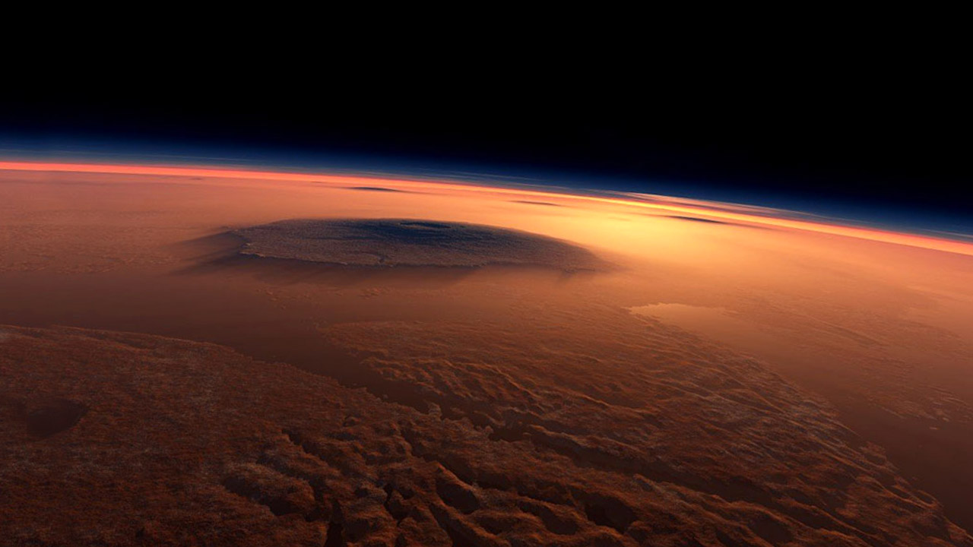



Mission to Mars!
Could we make mars habitable using terraforming?

Slide 2
WHAT IS IT?
TERRAFORMING
WHAT DOES IT MEAN?
Notes:
Encourage pupils to share what they think terraforming might mean/involve.
Terra is the Latin word for ‘Earth’ so the term literally means ‘Earth-forming’ or ‘Earth-shaping’, and is the process of modifying features of a planet (atmosphere, temperature, topography, ecology) to make it more similar to Earth and therefore habitable by (Earth-like) life (specifically humans!).

Slide 3
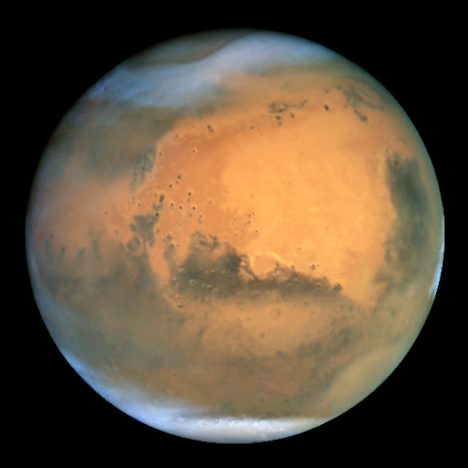
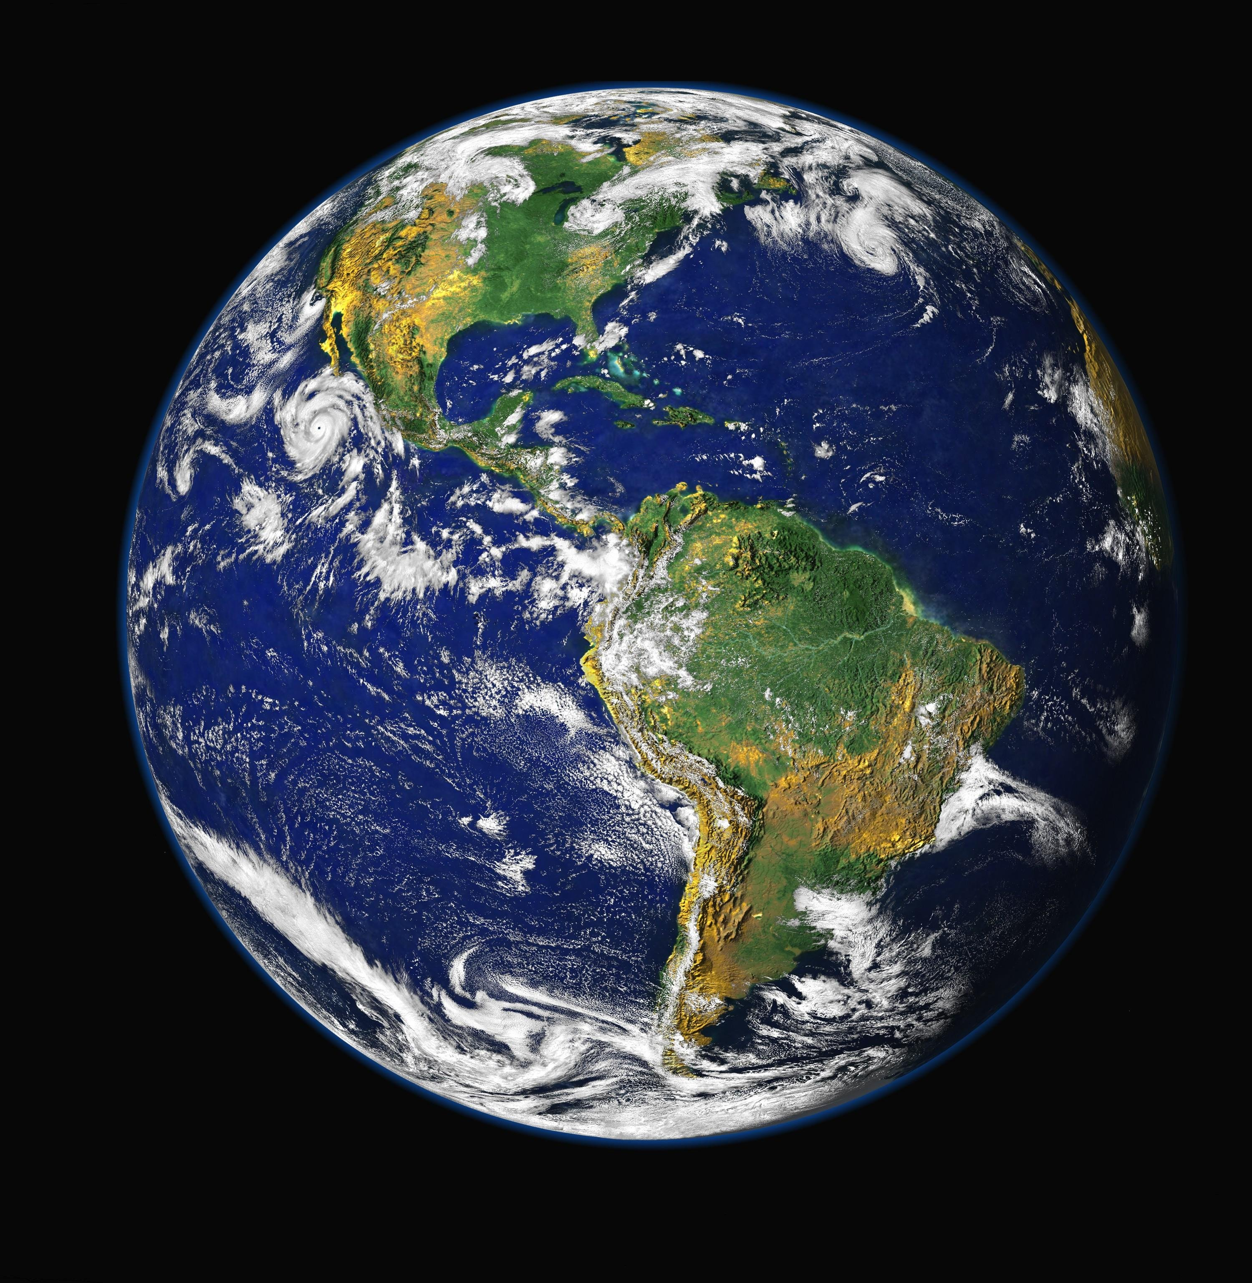
TERRAFORMING

Slide 4

Earth vs mars
Mars has many features that are similar to Earth, but currently humans cannot survive on the surface without life support (in the form of space suits)

Slide 5
What needs changed?
Temperature
Pressure
Water
Radiation
Atmosphere
Notes:
Five main things that are not quite right on Mars – need to change them all for humans to easily live …

Slide 6
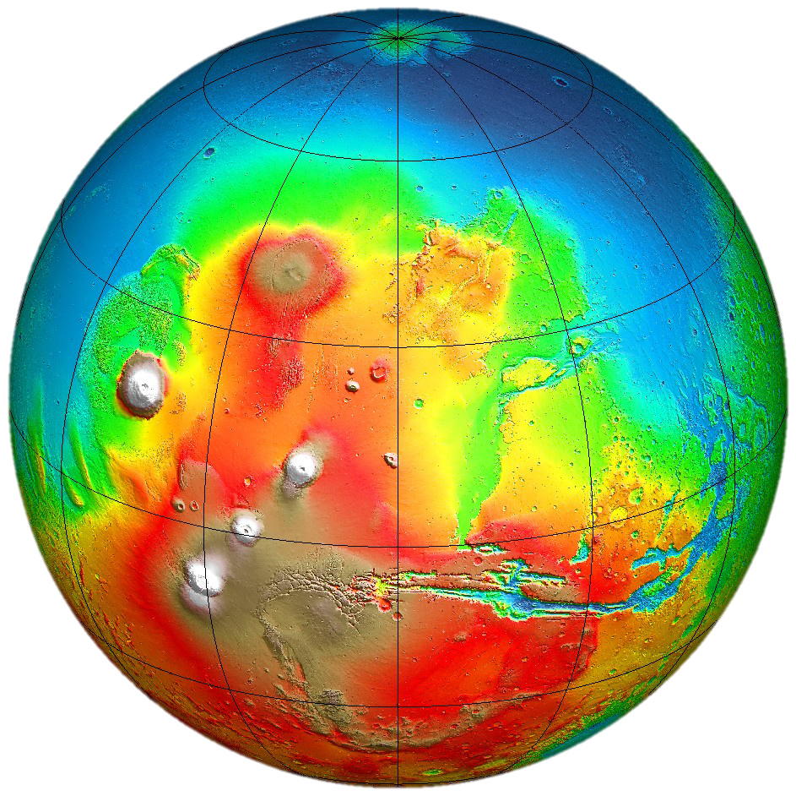
Temperature: too cold
Surface of Mars is currently -60°C
Survival temperature for humans is 0 - 30°C
Notes:
Ideas to heat up a planet …
Introduction of Greenhouse Gases (is this really a good idea!?)
Orbiting Mirrors - melting southern polar cap releasing CO2 (total melt of polar cap results in 70C increase)
Anaerobic micro-organisms (bacteria take in CO2 spit out O2 and methane or ammonia)
In situ factories (pump out greenhouse gases from air and soil)

Slide 7
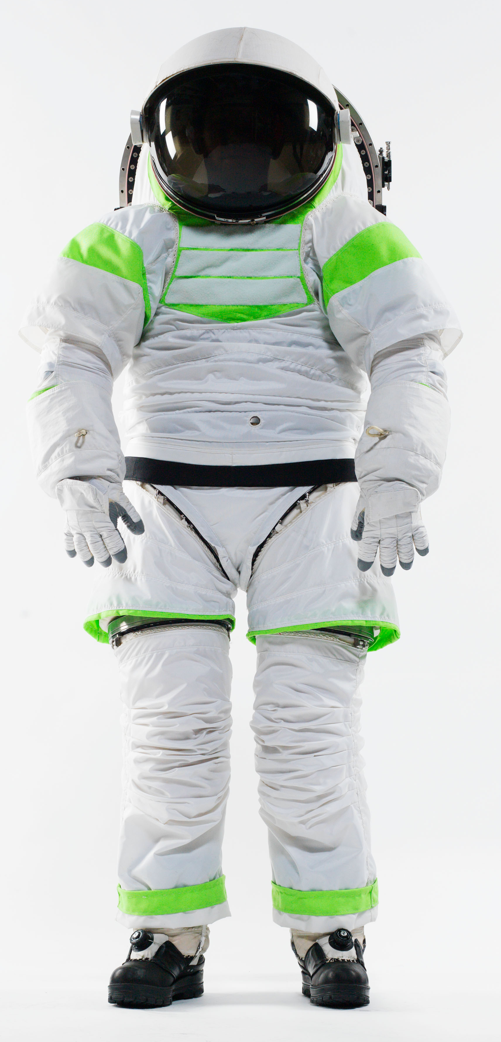
Pressure: too low
Surface pressure on Mars is currently only 8 millibars equivalent to 1% of sea level pressure on Earth - pressure suits are required
Pressure is related the thickness of the atmosphere, and also to temperature (warmer = higher pressure)
Notes:
Ideas to increase pressure …
CO2 from all of South polar cap and the regolith (released to bulk up atmosphere) give pressure of 300millibars (1/3 Earth sea level)
Greenhouse effect could give a atmospheric pressure of 1/8th to 2x that of Earth’s … partly unknown!

Slide 8
water: too little
There is good evidence of liquid water on Mars in the past, but none has (yet?) been discovered on the present day surface
There is thought to be water present as ice (including ice caps at the poles), and also locked up within Mars soil
Notes:
Ideas to release some of the stored water on Mars mostly involve heating the planet …
Should release water from - northern polar cap, soils?
There may also be groundwater reserves of water

Slide 9
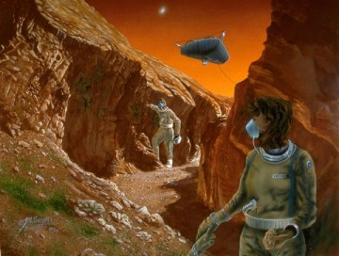
Oxygen: too little
Mars’ atmosphere is currently 95% carbon dioxide – breathing is only possible using an oxygen mask
Notes:
Ideas to increase oxygen in the atmosphere …
Photosynthetic plants (CO2 - O2) - genetic engineering? Would take time (and require some O2, water to get started)
Photosynthetic micro-organisms (CO2 - O2+) - few tough bacterial species, would also take time

Slide 10
Radiation: too much
UV
Solar Flares
Cosmic Rays
Notes:
Once the atmosphere problem has been solved (thickened) there should be sufficient protection from radiation
Useful article about protecting astronauts from radiation - https://www.nasa.gov/feature/goddard/real-martians-how-to-protect-astronauts-from-space-radiation-on-mars

Slide 11
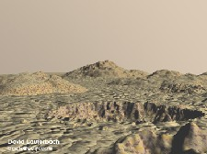
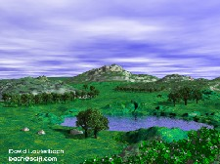
HOW LONG WILL IT TAKE?
Greenhouse effect
  - centuries
Pressure and Temperature
  - few decades to centuries
O₂ (photosynthesis)
  - several centuries at minimum
Melting of polar ice cap
  decade
… NOT A QUICK PROCESS!
Notes:
Once the pressure and temperature on Mars has been altered by the terraforming process, it will be much easier for large numbers of explorers to move to Mars to start a colony.
Once dome-like residential structures have been made, plants can be grown that will produce acceptable oxygen levels in these enclosed areas. Since planet wide oxygen levels will take a longer time to arrive at Earth-like levels, colonists will require O2 masks for outdoor excursions.
Unless we wait until technology advances significantly, Martian colonies would be on their own to construct a comfortable living environment - minimal interaction with Earth.

Slide 12
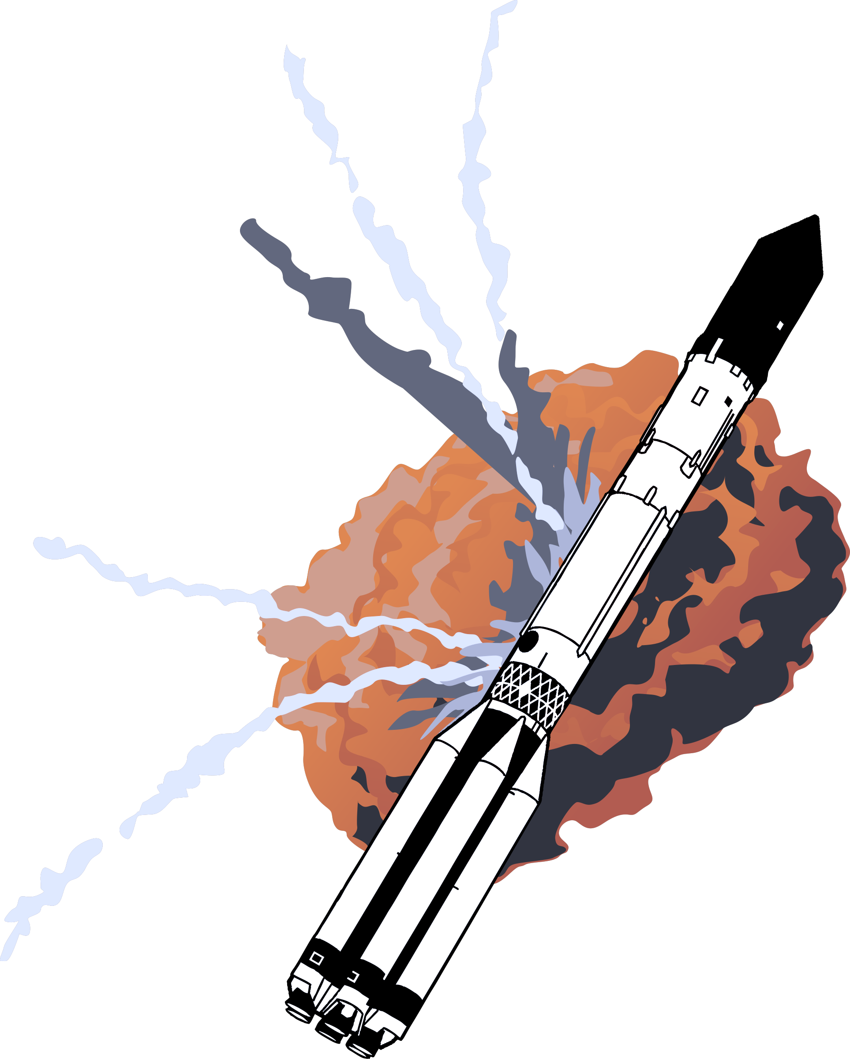


TERRAFORMING – CONSIDERATIONS
WORTH THE
EFFORT?
Terraforming process:
COST
TIME
FUTURE INTERACTION WITH SPACE
COLONIZATION

