Slide 1
INSTRUCTIONS
NB this activity can be used as a class demonstration on screen, sheets can be printed and given to groups to work independently, or the exercise can be expanded to be a computer based activity by plotting the data given in excel (such that pupils create the data graph themselves rather than being given a copy).
For each location shown on the map, data for δ¹³C and ¹⁴C is plotted on the graph.
Using the graph on slide 16 of the workshop, identify what the contribution of different CO₂ sources is likely to be by comparing where each source plots. For example, if the data plots high in the top right of the graph, this might represent an atmospheric source.
Data:
Sample # | δ¹³C (x-value) | ¹⁴C (y-value)
A | 0.00 | 0.01
B | -11.96 | 49.82
C | -3.17 | 73.41
D | -25.02 | 99.35

Slide 2
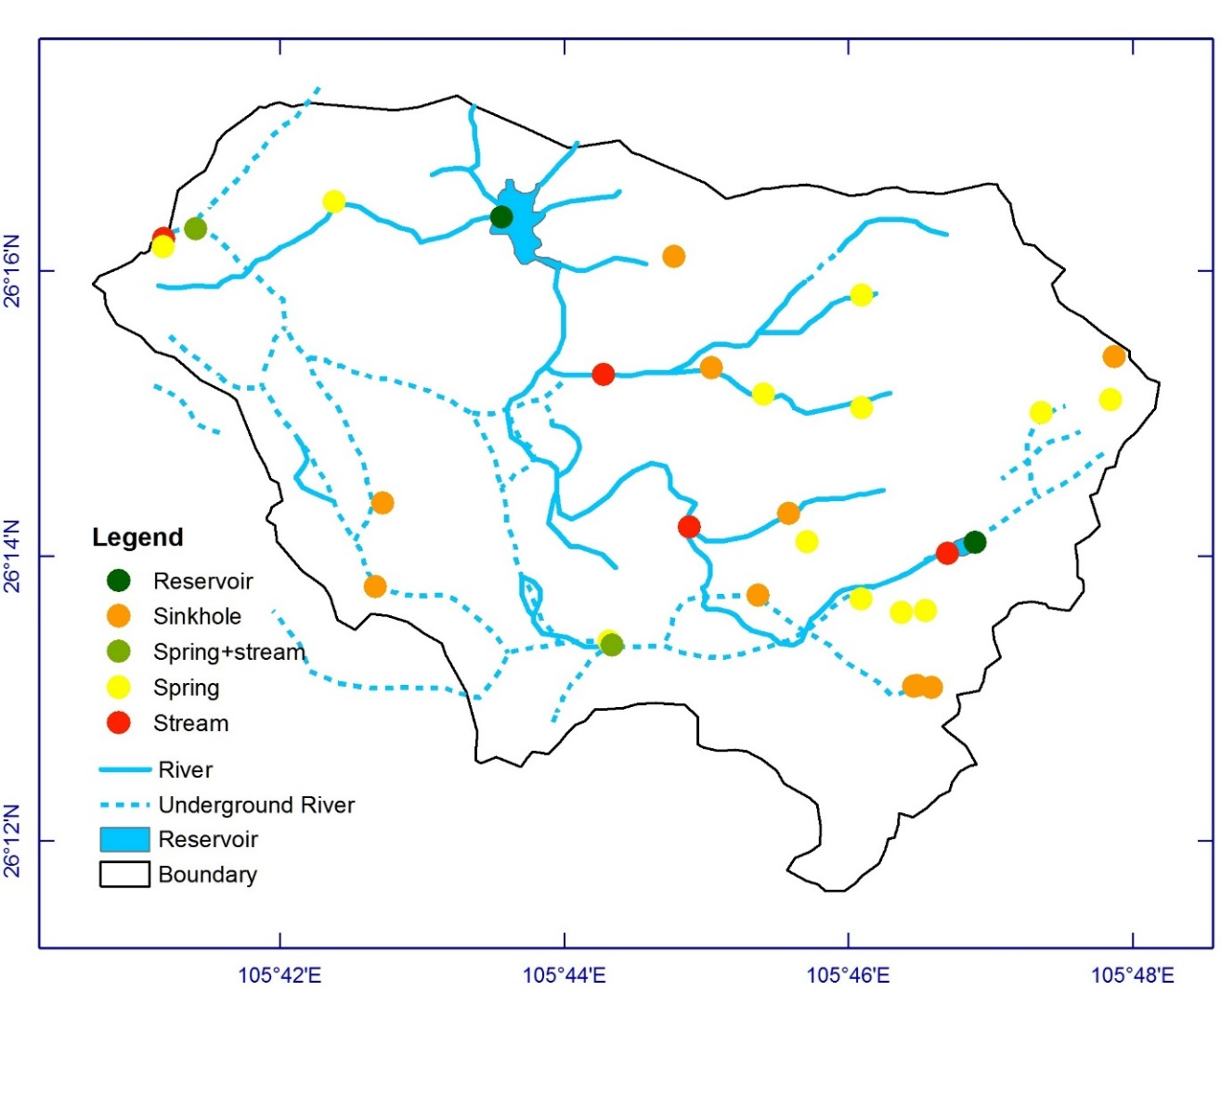
A
B
C
D
Notes:
Map showing location of samples taken

Slide 3
120.0
100.0
80.0
Sample
A
B
C
D
C (%modern)
60.0
40.0
14
20.0
0.0
-30.0
-25.0
-20.0
-15.0
-10.0
-5.0
0.0
δ
13
C (V-PDB, ‰)
Notes:
Graph of plotted data measured from samples

Slide 4
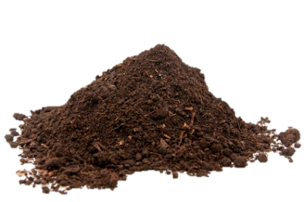
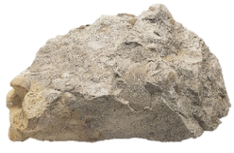
ANSWERS
120.0
Atmosphere
100.0
Sample C
Mixing with atmospheric source
Sample D
Mostly soil signature with some rock contribution
80.0
Sample
A
B
C
D
C (%modern)
60.0
40.0
Sample B
Contributions from rock and soil signature
14
Sample A
Carbonate rock signature
20.0
0.0
-30.0
-25.0
-20.0
-15.0
-10.0
-5.0
0.0
δ
13
C (V-PDB, ‰)

