Slide 1
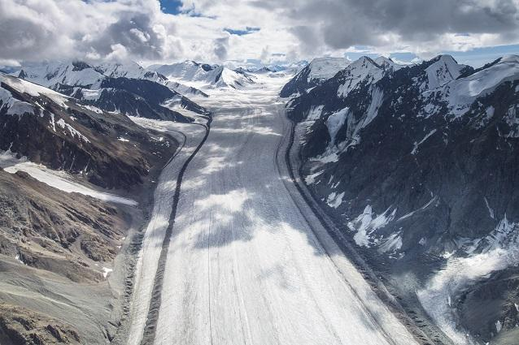


Glacial Erosion and Depositional Landforms
Notes:
Background Image - https://www.nps.gov/articles/valleyandpiedmontglaciers.htm

Slide 2
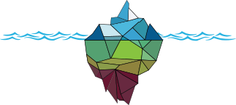
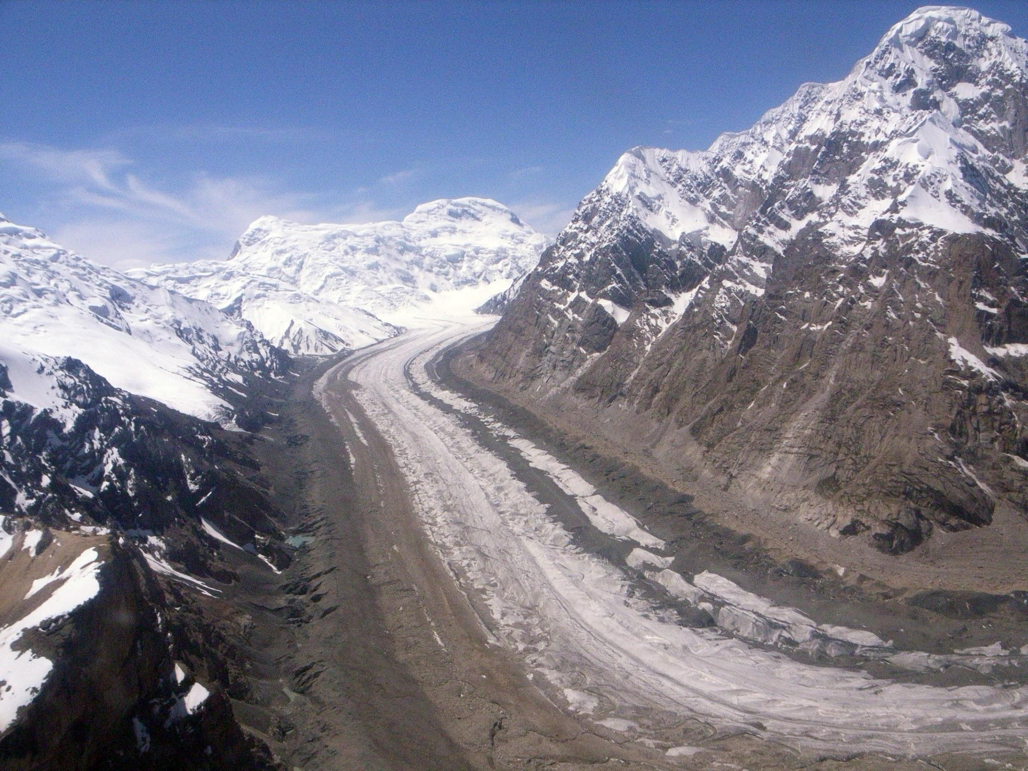
Erosion
Glaciers are powerful shapers of the landscape
They erode through two key processes:
    Plucking
    Abrasion
Tian Shan Glacier, Himalayas. Wikimedia.org
Notes:
Image - https://commons.wikimedia.org/wiki/Valley_glaciers

Slide 3
Erosion - Plucking
Plucking occurs when rocks or stones are frozen into the base and sides of the glacier
This debris is pulled from the ground as the glacier flows downhill
This leaves behind a jagged and rough landscape!

Slide 4
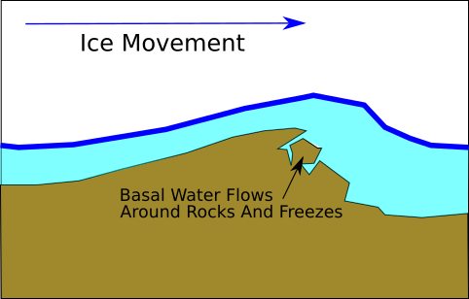
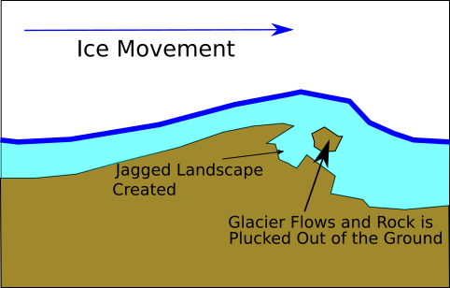
Erosion - Plucking
1.
R.Jones. GeoBus, St Andrews
2.
Notes:
Plucking Diagrams created by R.Jones, GeoBus, University of St Andrews

Slide 5
Erosion - Abrasion
Abrasion Occurs when rocks or stones which are embedded into the glacier scrape against the surrounding landscape
This can happen at the base or sides of the glacier
This scraping acts like sandpaper to wear down the landscape and leaves behind a smooth surface!

Slide 6
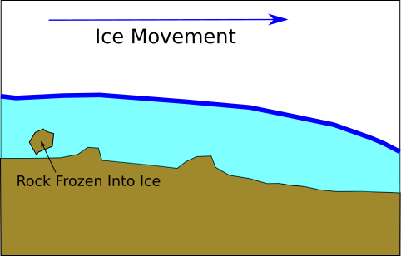
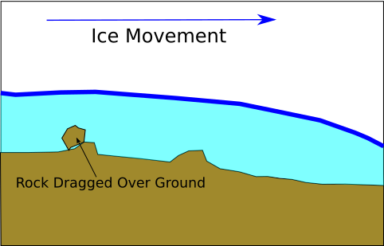
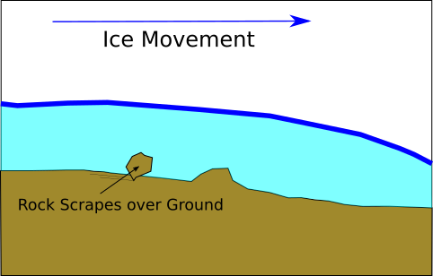
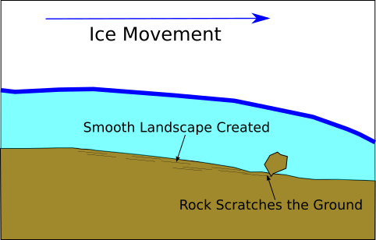
Erosion - Abrasion
1.
2.
3.
4.
R.Jones. GeoBus, St Andrews
Notes:
Abrasion Diagrams created by R.Jones, GeoBus, University of St Andrews

Slide 7
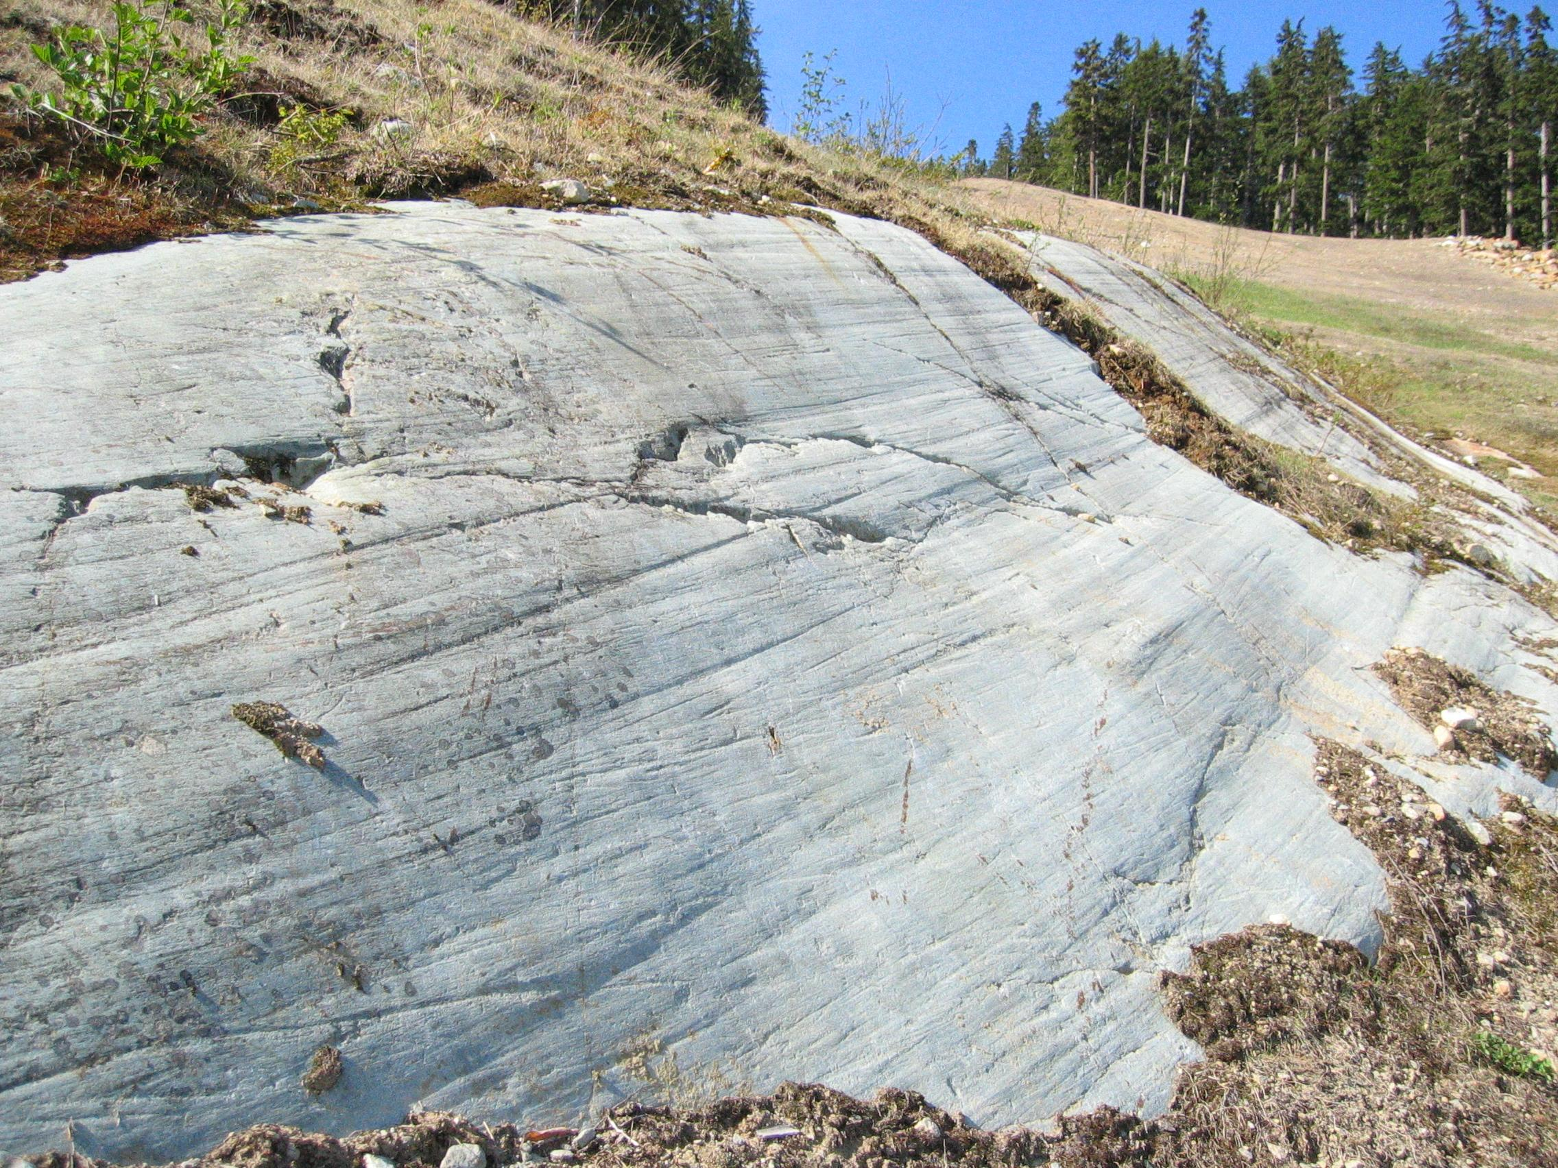
Erosion - Striations
Striations are scratches in the landscape which form during Abrasion, when debris scrapes over rock
These scratches can be big or small, and can still be seen today!
Striations on Granite, Whistler, Canada. Wikimedia.org
Notes:
Image Source - https://commons.wikimedia.org/wiki/File:Glacial_striations.JPG

Slide 8
Erosion - Corrie Formation
Corries, also named “Cirques”, are the starting points of glaciers
Snowflakes collect in a hollow and, if they do not melt, are compressed by more layers of snow piling up in the future
This build up of snow is called “Accumulation”
As more compression occurs over thousands of years the snow will recrystallise into snow and later glacier-ice
As the glacier-ice flows downhill, the hollow is steepened and deepened by plucking on the back wall and abrasion at the base
The resulting large hollow is called a “Corrie”. Often, these Corries fill with water leaving behind a “Corrie Lochan” (also called a “Tarn”).

Slide 9
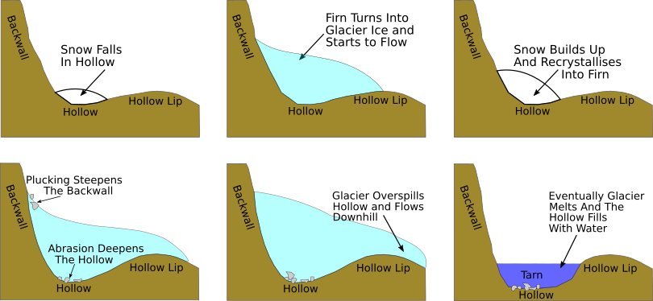
Erosion - Corrie Formation
1.
2.
3.
4.
5.
6.
R.Jones. GeoBus, St Andrews
Notes:
Corrie Formation Diagrams created by R.Jones, GeoBus, University of St Andrews

Slide 10
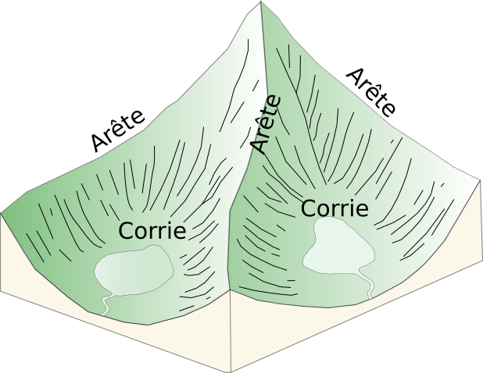
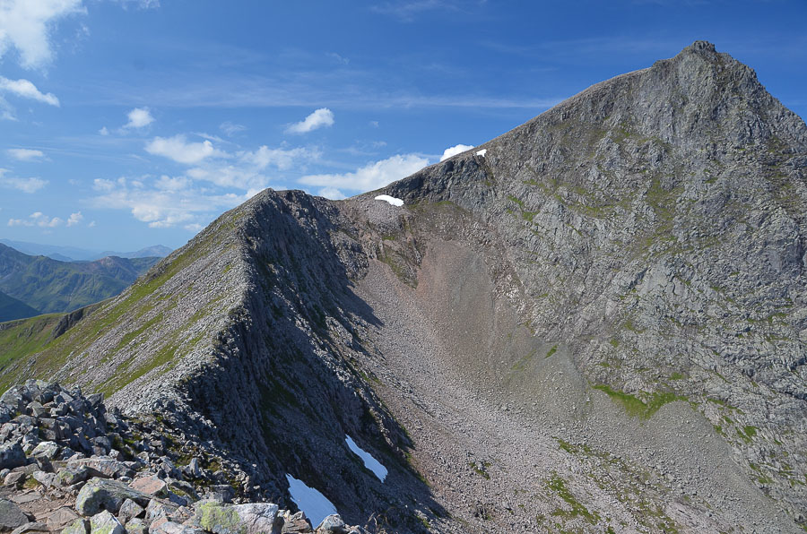
Erosion - Arête Formation
An “arête” is a sharp ridge which forms between two Corries
As a glacier erodes the corrie deeper, the arête becomes steeper and the ridge becomes narrower
Carn Mor Dearg Arete, Ben Nevis. Walkhighlands.co.uk
R.Jones. GeoBus, St Andrews
Notes:
Arete Formation Diagram created by R.Jones, GeoBus, University of St Andrews
Image - https://www.walkhighlands.co.uk/fortwilliam/carnmordeargarete.shtml

Slide 11
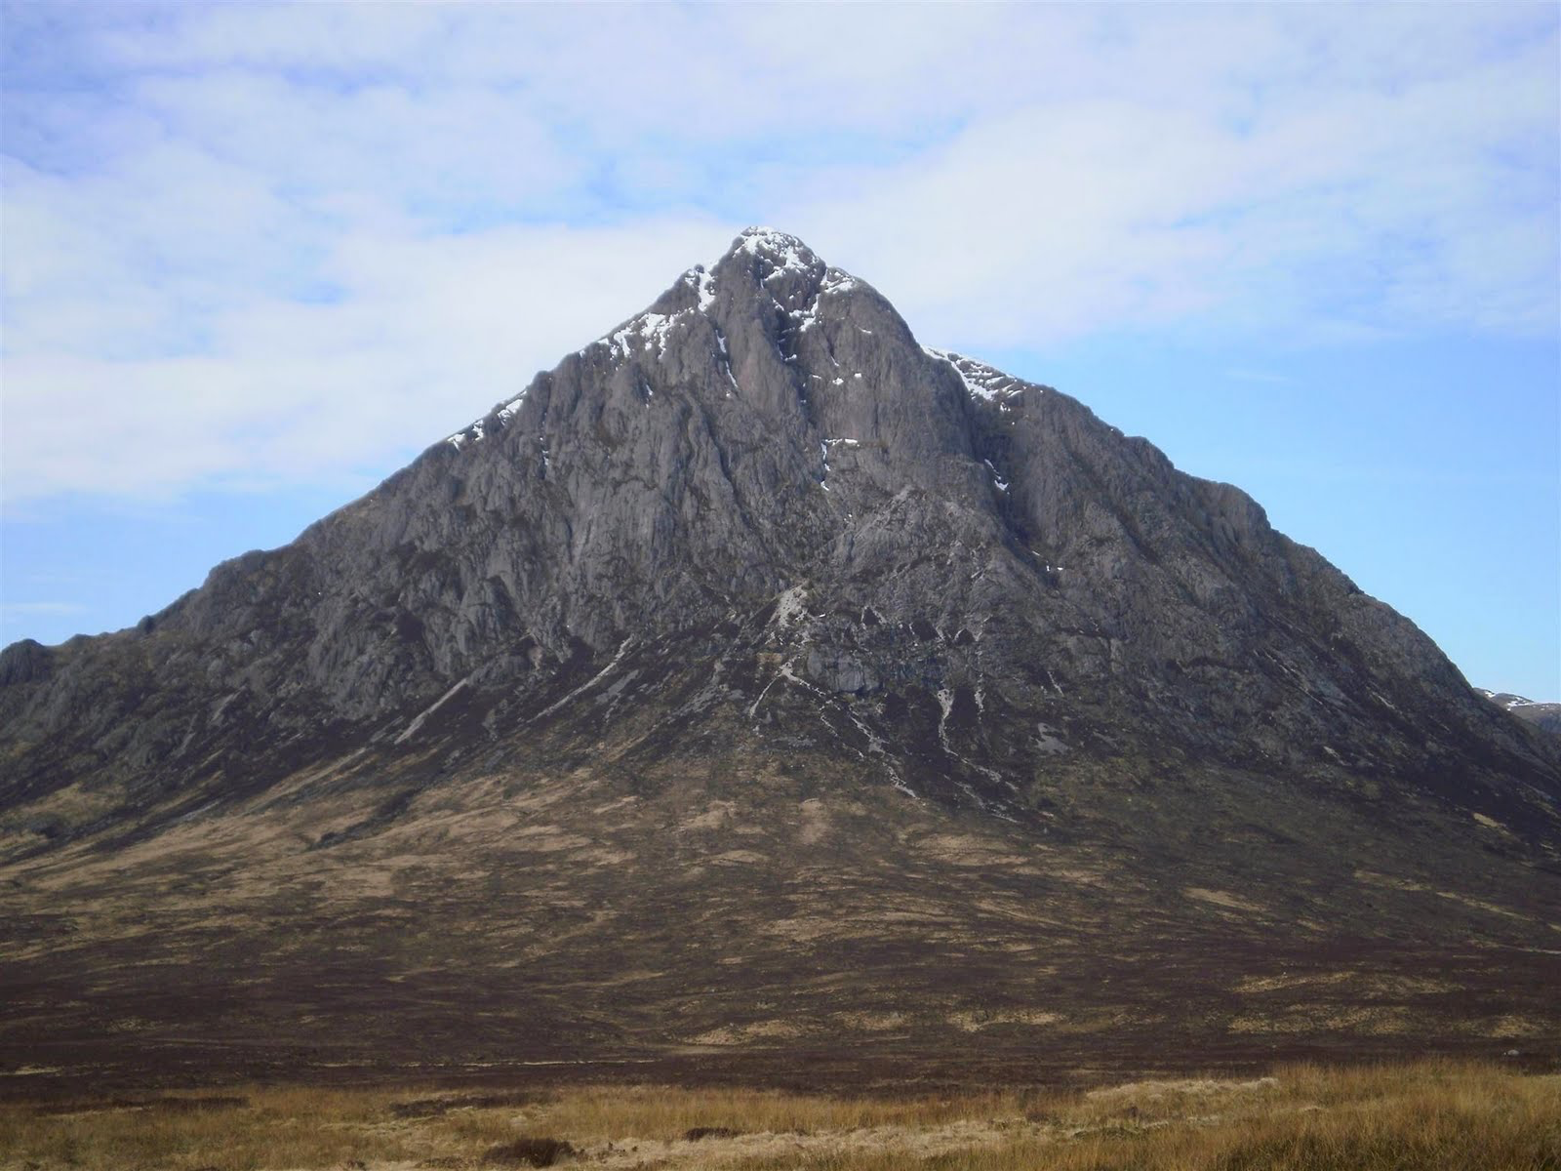
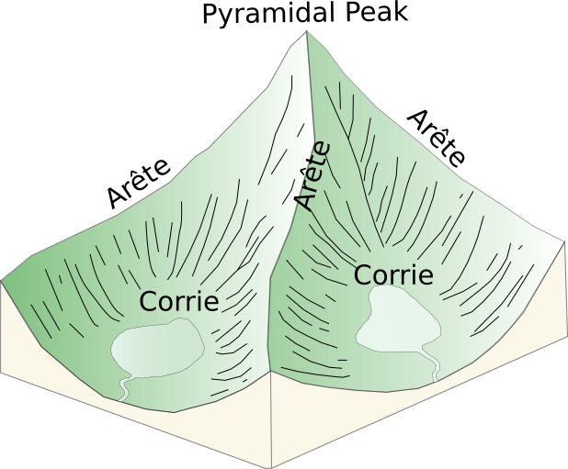
Erosion - Pyramidal Peak Formation
A “Pyramidal Peak” forms when three or more corries or arêtes meet
The meeting of the ridges creates a sharp peak in the shape of a pyramid
Famous examples of this include Mont Blanc, the Matterhorn and Everest!
Buachaille Etive, Scotland. Walkhighlands.co.uk
R.Jones. GeoBus, St Andrews
Notes:
Picture - https://www.walkhighlands.co.uk/Forum/viewtopic.php?f=9&t=4284
Pyramidal Peak Formation Diagram created by R.Jones, GeoBus, University of St Andrews

Slide 12
Erosion - U-Shaped Valley Formation
When a glacier flows through a V-Shaped river valley, it does not zig-zag round corners like the river does
Instead, the glacier erodes the valley deeper and wider through abrasion and plucking
Any land within the V-Shaped valley which the river had to flow around, such as “Interlocking Spurs”, the glacier erodes out of the way and produces “Truncated Spurs”.
This creates a wide glacial trough with steep sides and a flat base called a “U-Shaped Valley”.

Slide 13
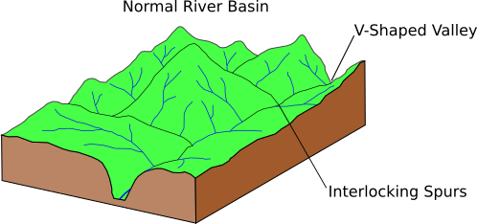
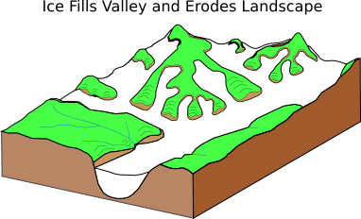
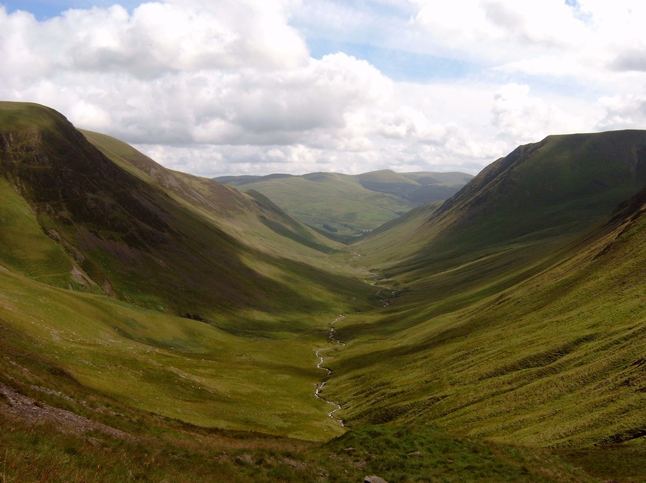
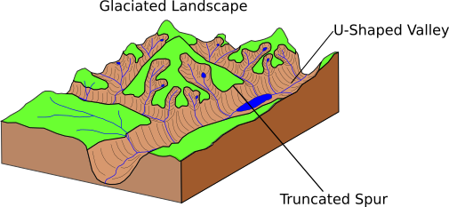
Erosion - U-Shaped Valley Formation
1.
2.
3.
R.Jones. GeoBus, St Andrews
Blackhope Valley, Southern Uplands, Scotland. Earthwise.bgs.ac.uk
Notes:
Image - http://earthwise.bgs.ac.uk/index.php/Record_of_climate_change,_Southern_Uplands

Slide 14
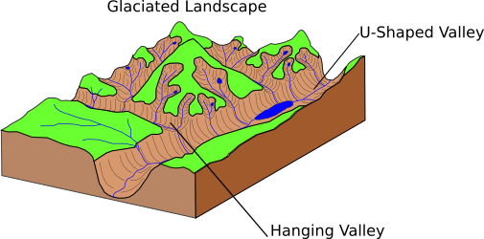
Erosion - Hanging Valley Formation
How deeply a glacier erodes the landscape can depend on how large the glacier is
Much like stepping on sand, the heavier you are the further you sink in!
When a smaller tributary glacier with a shallow trough meets a large glacier with a deep trough, the small trough is left “hanging” above it
When the ice melts, the empty hanging valley
is left visible
This is known as a “Hanging
Valley”
R.Jones. GeoBus, St Andrews

Slide 15
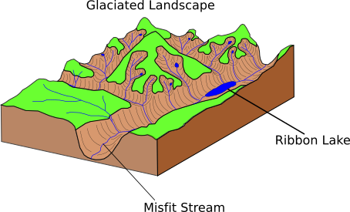
Erosion - Water in a U-Shaped Valley
After a glacier has melted the U-Shaped Valley is left behind
If the stream that originally flowed down the V-Shaped Valley before the glacier came along comes back, it is known as a “Misfit Stream”
This is because the stream is out of place in such a big valley!
If the glacier erodes a hollow in the valley in less-resistant rock, this hollow can fill up with water
This long, thin lake is called a “Ribbon Lake”
R.Jones. GeoBus, St Andrews

Slide 16
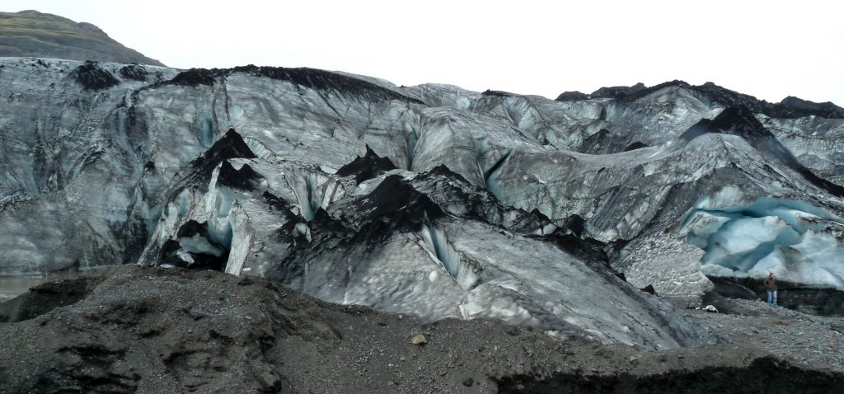
Transportation of Debris
Glaciers transport large amounts of debris
This debris can be from rock-falls onto the glacier from the valley sides or scraped up from the valley floor
It can be transported on the surface of the glacier, called “Supraglacial Transport”
Or buried within the ice, called “Englacial Transport”
Or along the base of the glacier, called
“Subglacial Transport”
The debris left behind by a glacier is
called “Till ”.
Sólheimajökull glacier, Southern Iceland. blogs.staffs.ac.uk
Notes:
Image source - https://blogs.staffs.ac.uk/geography/2016/06/26/black-ice-dirty-ice/

Slide 17
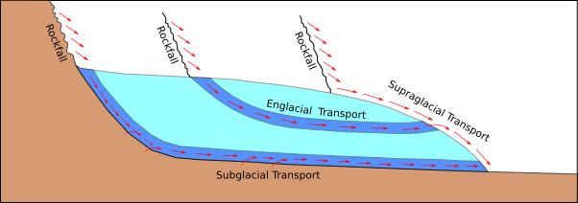
Transportation of Debris
But what happens to this debris?

Slide 18
Deposition - Moraine Formation
As a glacier erodes the landscape it bulldozes large volumes of till out of its way
The resulting mounds of debris created around the glacier are called “Moraines”
The debris at the front of the glacier is called a “Terminal Moraine”
The debris at the side of the glacier is called a “Lateral Moraine”
When two glaciers join together into one their Lateral Moraines merge on the inside, leading to a line of debris running down the middle of the new larger glacier. This is called a “Medial Moraine”

Slide 19
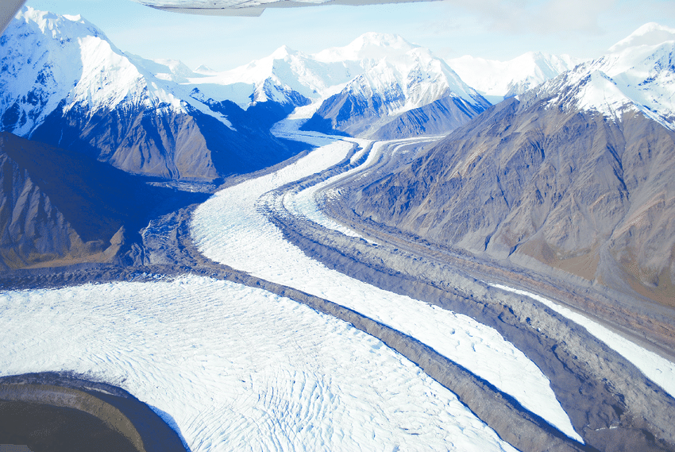
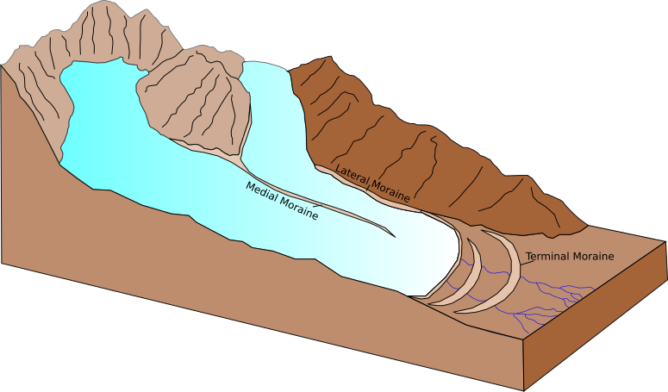
Deposition - Moraine Formation
Alaska. Researchgate.net
R.Jones. GeoBus, St Andrews
Notes:
Image - https://www.researchgate.net/figure/Medial-moraine-Alaska-In-this-photo-merging-glaciers-form-a-medial-moraine-between-two_fig3_309133433

Slide 20
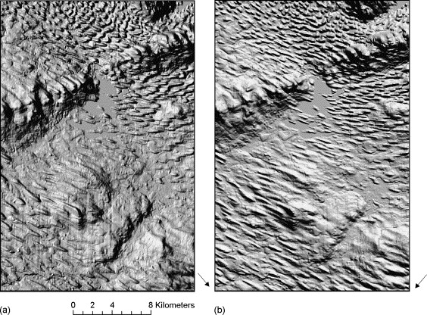
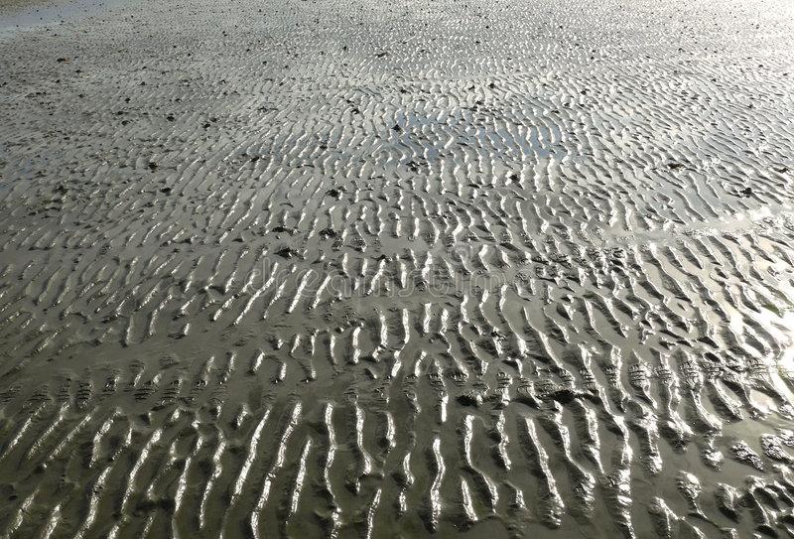
Deposition - Drumlin Formation
A “Drumlin” is a streamlined ridge of sediment which is shaped beneath the glacier
When a glacier flows, it moulds and deforms its bed and creates regular patterns
These mounds that are created are called Drumlins, and resemble ripples in the sand you see at a beach
Satellite image of Drumlins. Smith and Wise, 2007.
Sand Ripples. Dreamstime.com
Notes:
Drumlin Image - https://www.sciencedirect.com/science/article/pii/S0303243406000225
Sand Ripples - https://www.dreamstime.com/royalty-free-stock-images-sand-ripples-beach-image3794279

Slide 21
Deposition - Esker Formation
An “esker” is a long thin mound of sediment deposited by a glacier
These form when melt-water channels within a glacier fill with sediment
When the glacier melts, the channel of sediment is left behind
Some of these channels are on the surface of the glacier, some within the glacier itself and some at the base
Eskers can be several kilometres in length

Slide 22
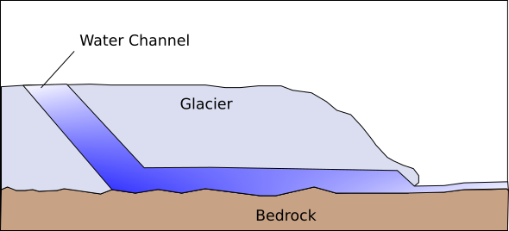
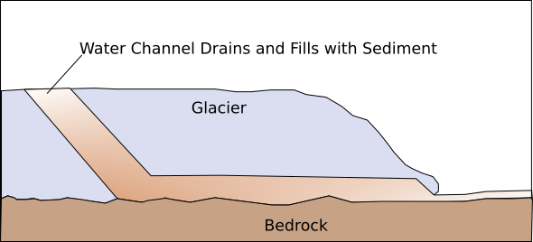
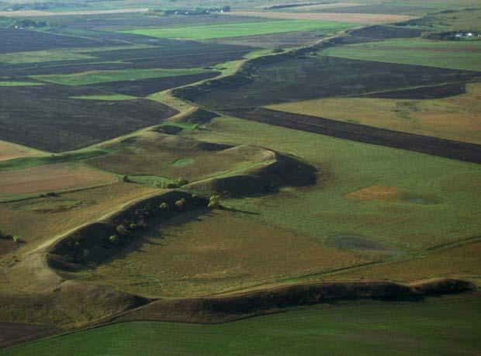
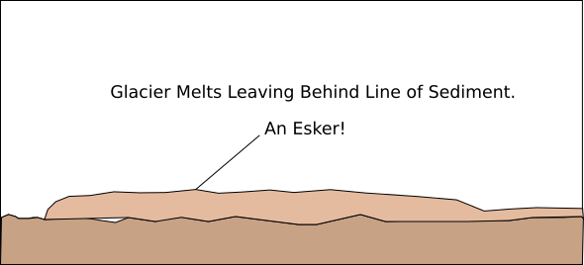
Deposition - Esker Formation
1.
2.
3.
R.Jones. GeoBus, St Andrews
Esker in South Dakota. Alaskashoretours.com
Notes:
Image - https://alaskashoretours.com/alaska-ice-caves/

Slide 23
True or False
When a lake forms inside a corrie, it is called a Ribbon Lake.
True or False

Slide 24
True or False
When a lake forms inside a corrie, it is called a Ribbon Lake.
True or False
False! When a lake forms inside a corrie, it is called a Tarn.

Slide 25
True or False
An esker is a long line of sediment which used to fill a water channel within a glacier.
True or False

Slide 26
True or False
An esker is a long line of sediment which used to fill a water channel within a glacier.
True or False

Slide 27
True or False
Scrapes over a land scape left behind by glacier abrasion are called hanging valleys.
True or False

Slide 28
True or False
Scrapes over a landscape left behind by glacier abrasion are called hanging valleys.
True or False
False! Scrapes over a landscape left behind by glacier abrasion are called Striations.

