Slide 1
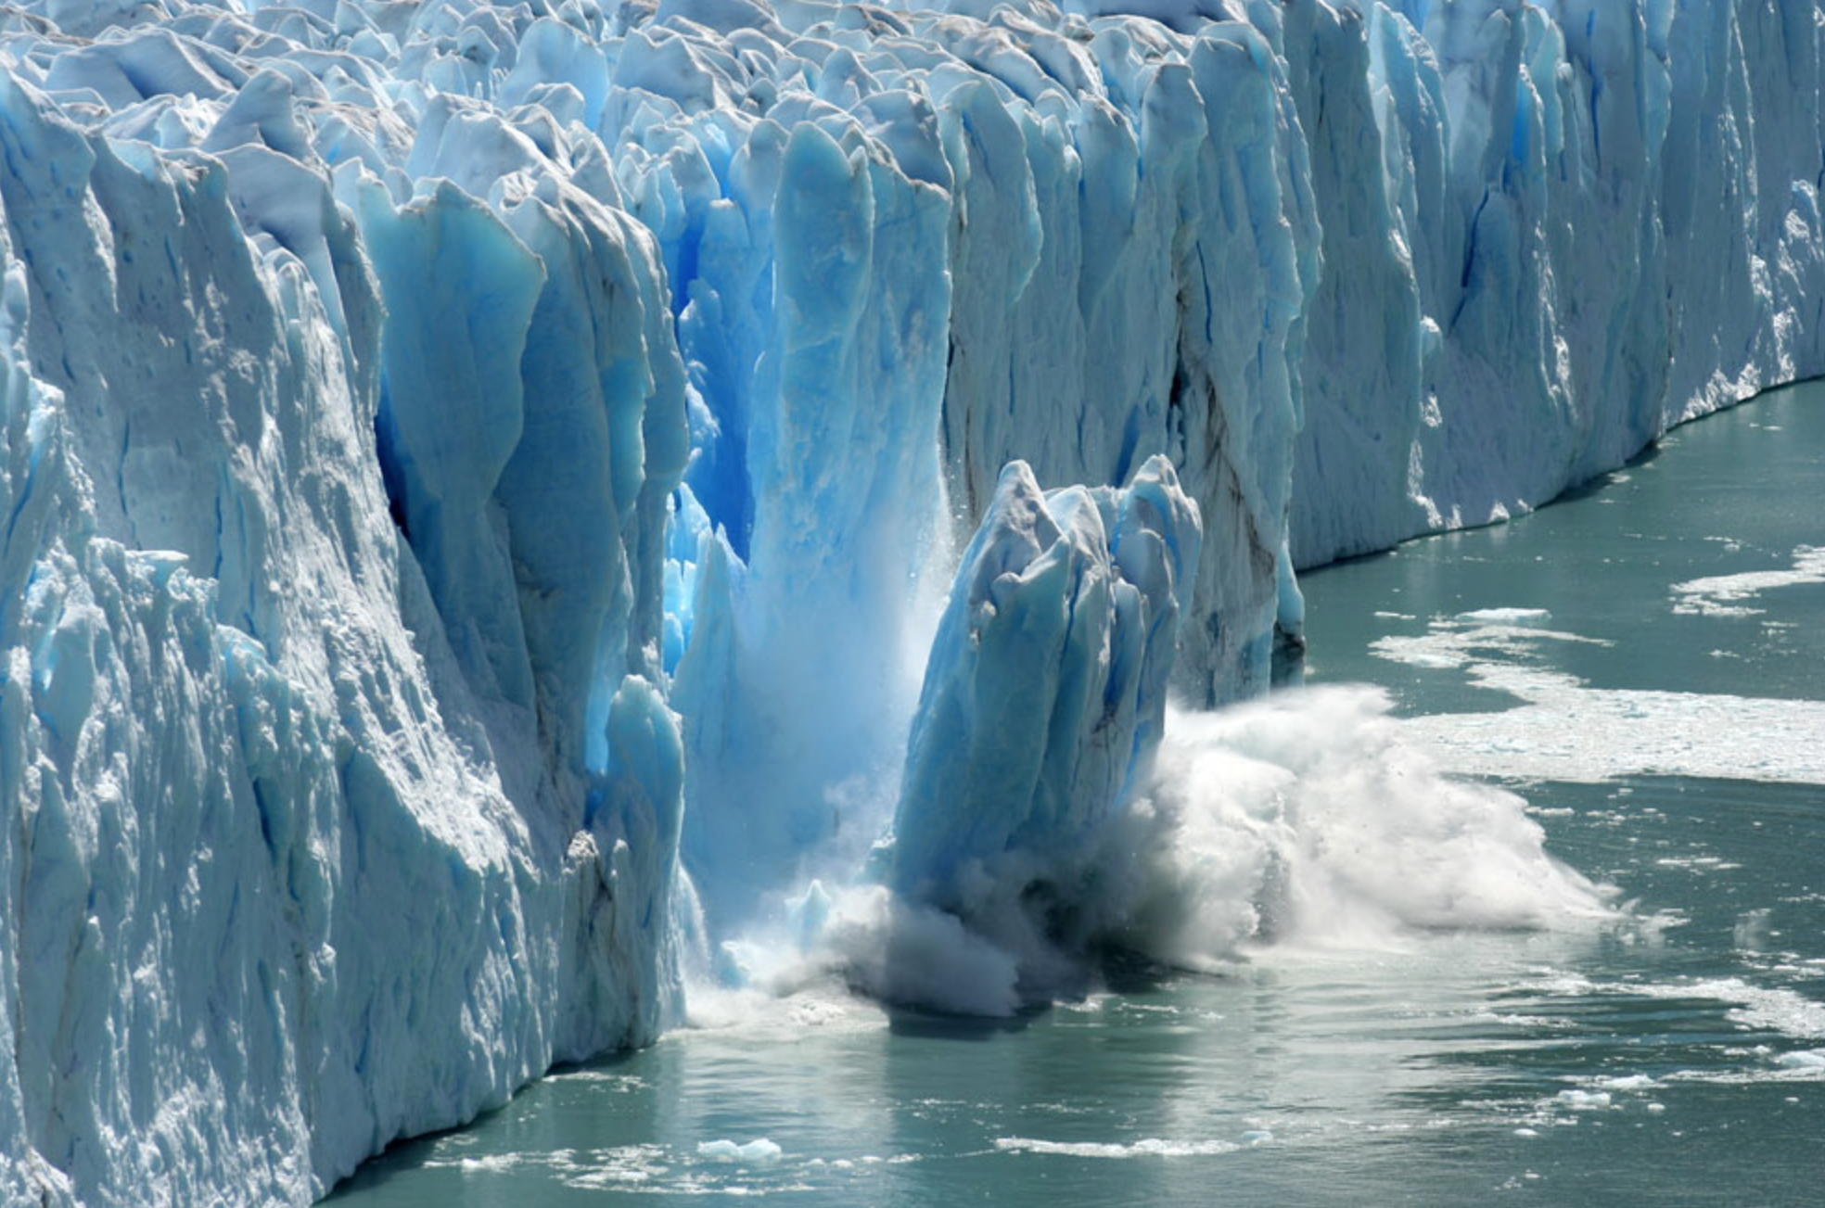
Glaciology
Glacial Calving
Notes:
Image source: https://www.terrain.org/wp-content/uploads/2015/06/glacial-calving.jpg

Slide 2
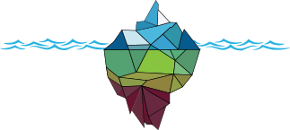
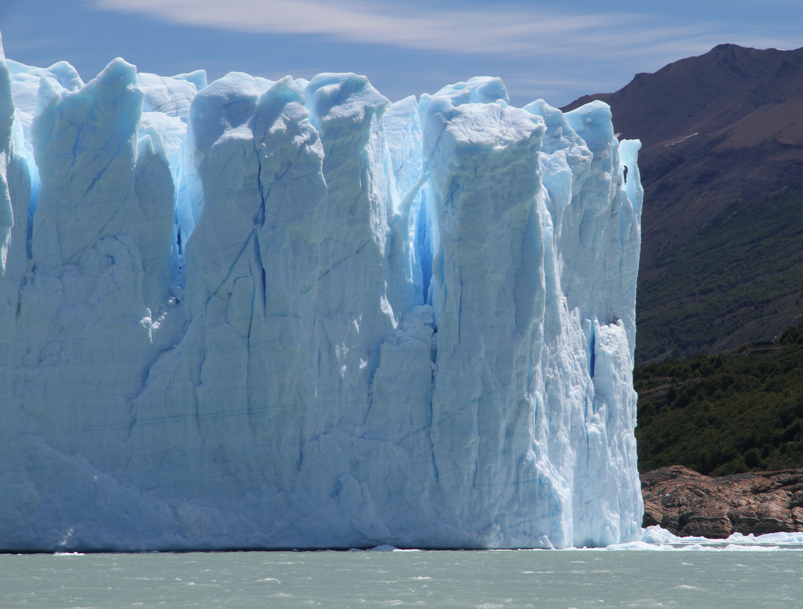
What is Calving?
Calving is defined as the mechanical loss of ice from glaciers and ice shelves
When a glacier ends in water, a cliff is created
If cracks at weak points in the ice can penetrate right through the glacier, bits of ice - icebergs - can break off
A glacial cliff courtesy of A New American Paradigm
Notes:
Can draw a simple image of a glacier cliff with cracks getting progressively bigger until an iceberg falls off / show one minute video
When these icebergs break off, the glacier has “calved”
Image source: http://newamericanparadigm.com/?p=490

Slide 3
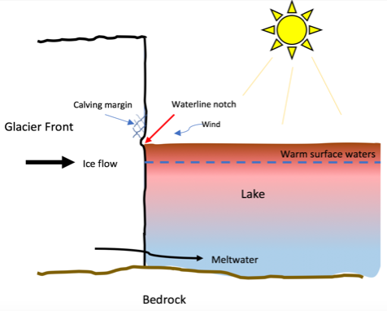
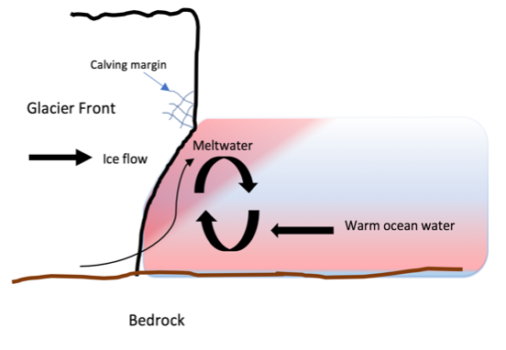
How does it work?
B.
Calving at Lake Terminating glaciers.
The sun warms the upper layers of the water which causes melt at a waterline notch and ice break-off.
B. Calving at Marine Terminating glaciers.
Warm ocean water undercuts the glacier creating an overhang which eventually breaks off.
A simplified sketch showing melt undercutting at a) a lake-terminating and b) a marine-terminating glacier (C. Keane, 2018)
Notes:
Point out:
The glacier front and direction of ice flow
Calving margin
Explain the process happening here (warm lake waters = causing cracks in the glacier front (left) and warm ocean waters undercutting and making the glacier cliff steeper (right)) ⇒ lead to a calving event

Slide 4
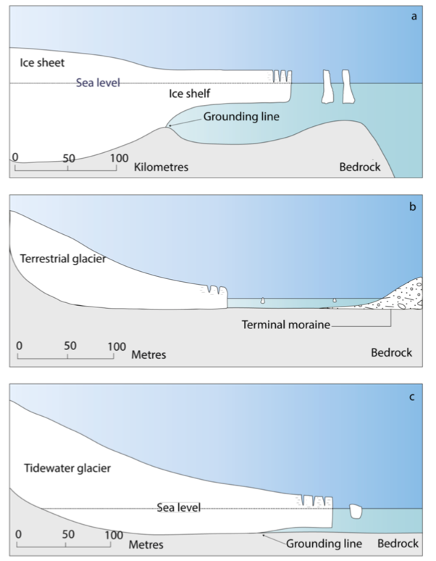
Calving Margins
Unstable ice shelf with bedrock which slopes downwards inland
b. Lake terminating glacier
c. Stable marine terminating ice sheet
with a bed which slopes upwards
Simplified cross sections of different calving margins (Bell, 2017).
Notes:
Simplified cross sections of different calving margins. a) Ice sheets terminating into ocean waters, e.g. Ross Ice Shelf, Antarctica; b) Lake-terminating glacier terminating in shallow e.g. Fjallsjökull glacier in Iceland; c) Marine-terminating glacier, e.g. Kronebreen glacier, Svalbard (Bell, 2017) - Courtesy of C. Keane.

Slide 5
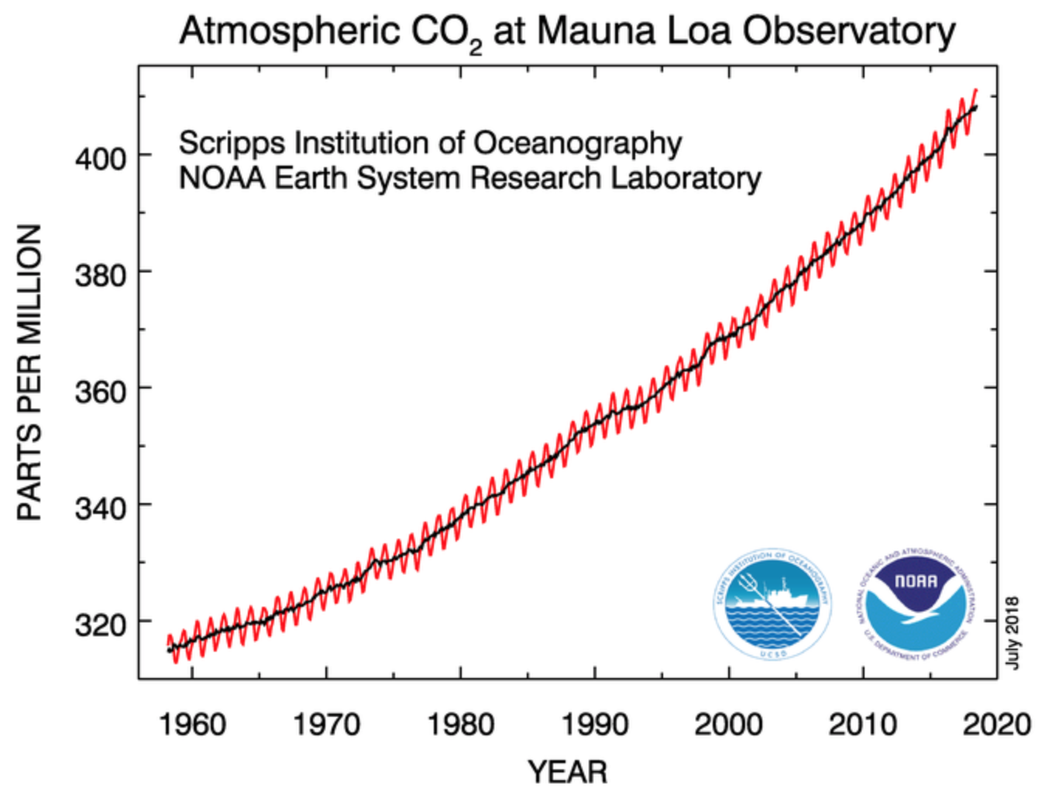
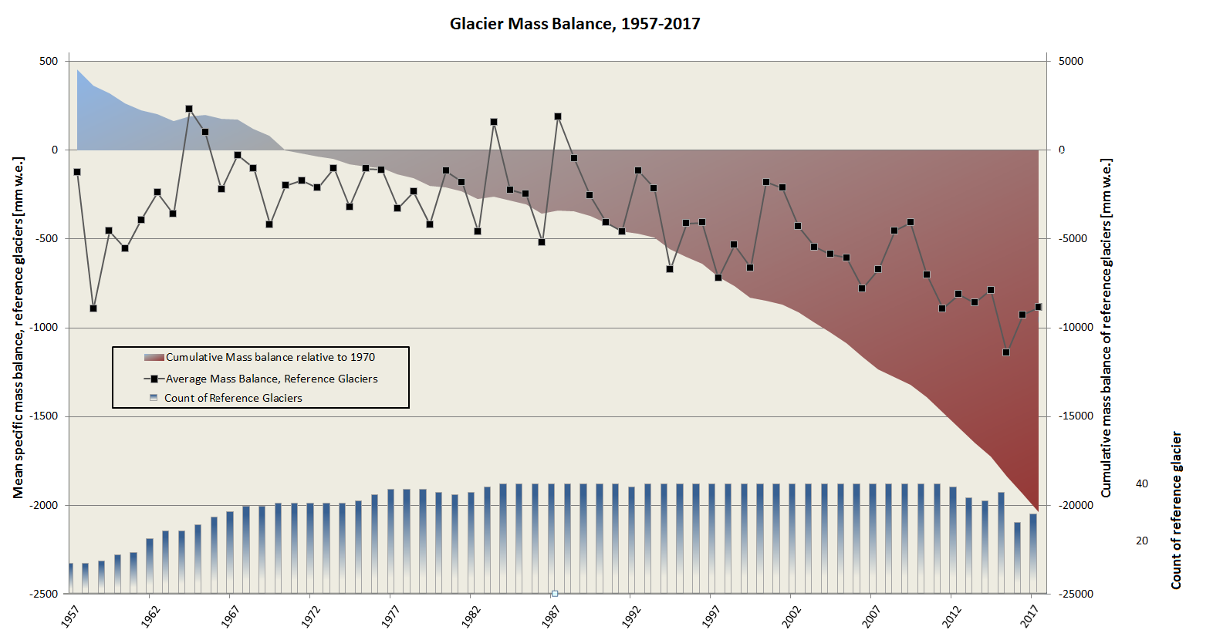
Why is it important?
Calving is a vital and effective ablation mechanism and thus a major component of the mass balance of many glaciers worldwide
Since the 19th century, there has been a rapid increase in the rate of glacial recession, likely due to the global warming associated with increased concentrations of CO₂
Graph of atmospheric CO2 at Mauna Loa Observatory courtesy of the NOAA.
Graph of glacier mass balance over time courtesy of the global cryosphere watch.
Notes:
CO2 image source: https://www.esrl.noaa.gov/gmd/webdata/ccgg/trends/co2_data_mlo.png
Glacier Mass Balance Image: https://globalcryospherewatch.org/assessments/glaciers/

Slide 6
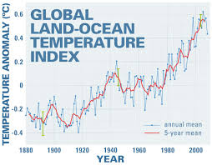
Why is it important?
Increased concentrations of CO₂ have caused air and ocean temperatures to rise
This has resulted in an increase in mass loss via supraglacial and subglacial melting and by iceberg calving
Graph showing the global land-ocean temperature index courtesy of NASA
Notes:
Image source: https://www.nasa.gov/topics/earth/features/upsDownsGlobalWarming.html

Slide 7
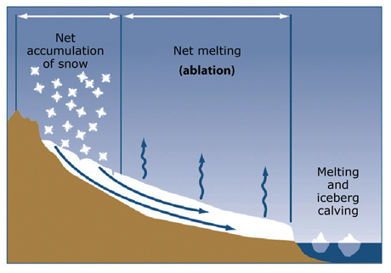
Significance of Calving
Calving accounts for up to 50% of the mass transfer from glaciers to the ocean
Accounting for ~70% of the mass loss from the Antarctic Ice Sheet and over 50% of the mass loss from the Greenland Ice Sheet
Diagram showing how calving contributes to the transfer of glacier mass to the ocean, courtesy of Antarctic Glaciers.
Notes:
Image Source: http://www.antarcticglaciers.org/modern-glaciers/glacier-flow-2/glacier-flow/

Slide 8
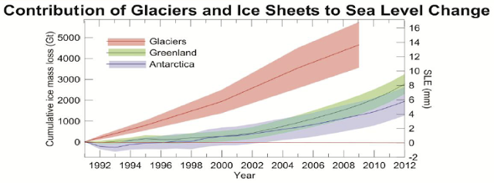
Sea Level Rise
As a result of this, calving contributes to global sea level rise in two ways:
1) releasing icebergs into the ocean
2) reduced resistance encourages increased ice discharge
Graph of the cumulative ice mass loss from glaciers and ice sheers in sea level equivalent (IPCC, 2013)

Slide 9
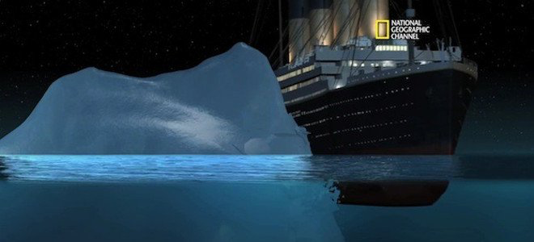
Impacts of Calving
As well as contributing to global sea level rise, calving is hazardous to human life and infrastructure
Large icebergs can fall into water bodies and cause tsunami-like waves
These have the potential to flood nearby areas, destabilise ships and boats, and also injure tourists
Cartoon of the Titanic hitting an iceberg courtesy of the National Geographic
Notes:
In 1941, a large iceberg calved into Lake Palcacocha in Peru. This triggered a glacial outburst flood which flooded the city of Huaraz. This killed approximately 5,000 people (Carey, 2005).

Slide 10
True or False
Calving is the breakoff of icebergs at the front of a glacier.
True or False

Slide 11
True or False
Calving is the breakoff of icebergs at the front of a glacier.
True or False

Slide 12
True or False
Calving is a minor component of the mass balance of glaciers worldwide
True or False

Slide 13
True or False
Calving is a minor component of the mass balance of glaciers worldwide
True or False
False! Calving plays a major role in the mass balance of glaciers worldwide as it is a key factor in Ablation.

Slide 14
True or False
Calving has increased in line with global temperature increases, the result of increased concentrations of atmospheric CO₂
True or False

Slide 15
True or False
Calving has increased in line with global temperature increases, the result of increased concentrations of atmospheric CO₂
True or False

