Slide 1
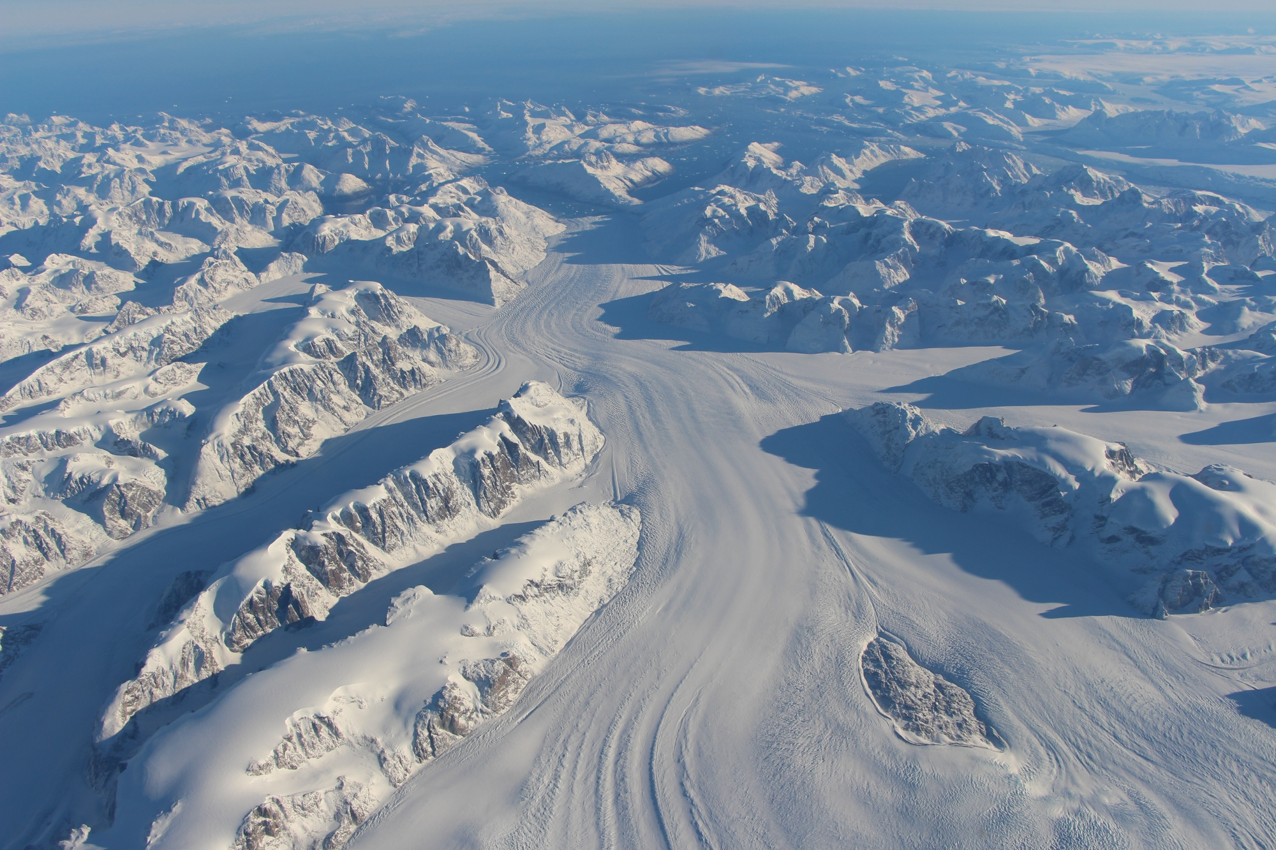


Glaciology
What is Glacier Surging?
Notes:
Background image - https://www.nasa.gov/feature/goddard/2016/nasa-usgs-landsat-8-satellite-provides-global-view-of-speed-of-ice

Slide 2
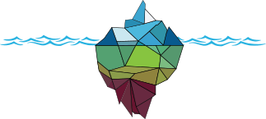
Normal Glacier Motion
A glacier flows downhill through different mechanisms:
“Internal deformation” of Ice (creep)
“Sliding” at the glacier bed
Deformation of basal sediments
Notes:
Internal Deformation - changes in crystal structure due to weight and pressure of the ice.
Sliding - water at the base causing the ice to slip over the surface of the bed.
Deformation of Basal Sediments - weight of glacier moving the sediment beneath it to move downhill.

Slide 3
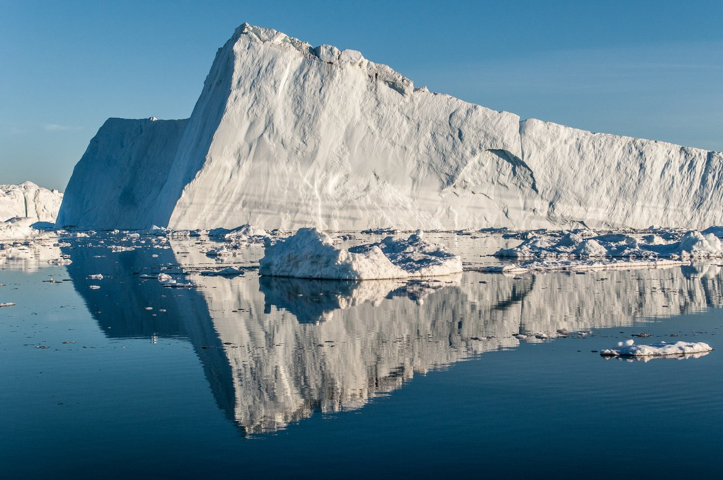
Normal Glacier Velocity
Glaciers are slow!
Normally, glaciers move just a few centimeters a day
So slow, it looks like they aren’t moving at all
Iceberg from Jakobshavn Glacier. Washington.edu
Notes:
Image: https://www.washington.edu/news/2014/02/03/greenlands-fastest-glacier-sets-new-speed-record/

Slide 4
What Are Glacier Surges?
Surges are switches between slow and fast flow, with the fast flow occurring for a few years
Surges are not directly triggered by external factors (e.g. climate), but instead are a combination of internal and external factors
The velocity of the glacier can increase up to ten or more times the normal speed!

Slide 5

Example of a Surge
Video of Skobreen Surge, Svalbard. Taken by Kristensen and Benn, 2012
Notes:
Video Source - https://www.tandfonline.com/doi/full/10.3402/polar.v31i0.11106?scroll=top&needAccess=true

Slide 6
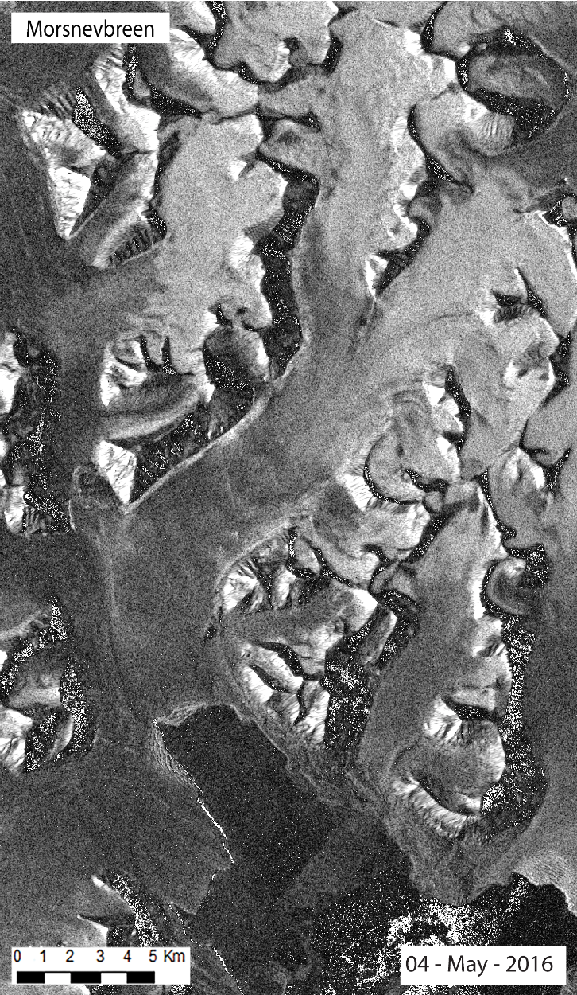
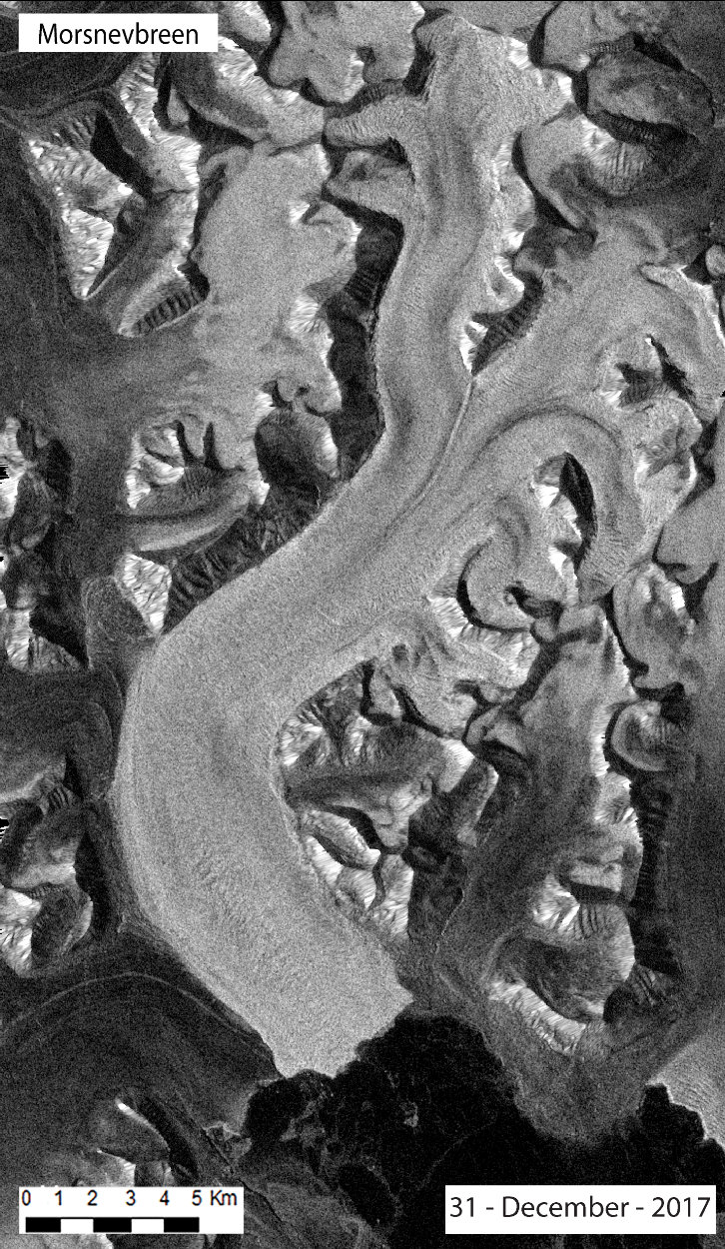
Example of a Surge
Left: Satellite image of Morsnevbreen glacier, Svalbard, May 2016.
Right: Satellite image of Morsnevbreen glacier, Svalbard, December 2017.
Images from R.Jones, University of St Andrews.

Slide 7
Where Do They Occur?
Not all glaciers in the world surge, as certain conditions are required
It is estimated that only ~1% of the global glacier population are of surge-type
Surge-type glaciers are clustered within specific glaciated regions within the world

Slide 8
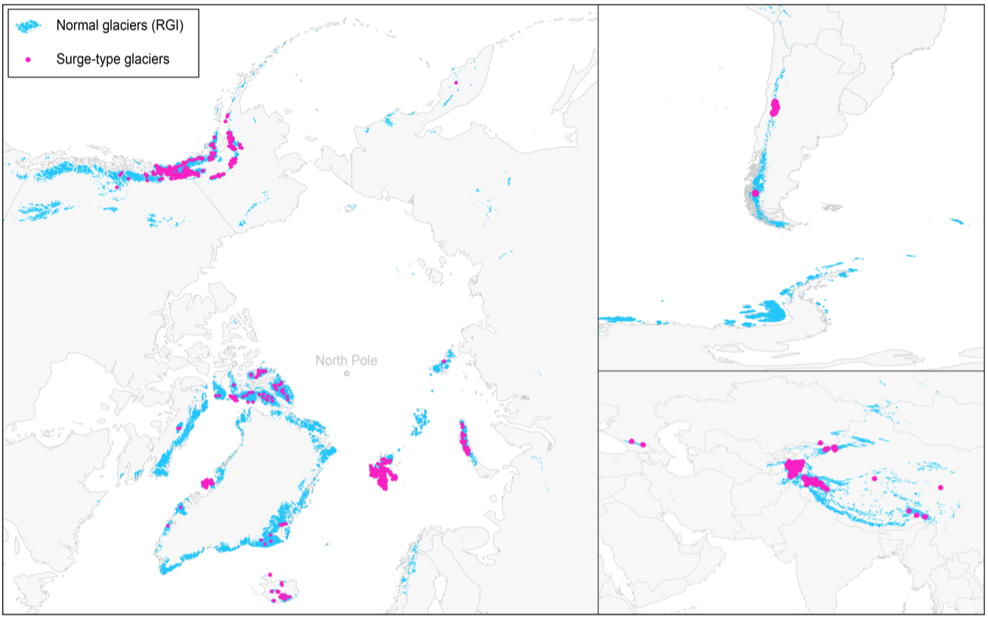
Where Do They Occur?
Map of Normal Glaciers (Blue) and Surge-Type Glaciers (Pink). Sevestre and Benn, 2015
Notes:
Surge-type glaciers are common in the Arctic Ring or High Mountain Asia.
They are not uniformly distributed.
Image - https://www.cambridge.org/core/services/aop-cambridge-core/content/view/34D15501CBBF803608401FEAA6B0FC61/S0022143000202487a.pdf/climatic_and_geometric_controls_on_the_global_distribution_of_surgetype_glaciers_implications_for_a_unifying_model_of_surging.pdf
Map - Sevestre & Benn, 2015 - https://www.cambridge.org/core/services/aop-cambridge-core/content/view/34D15501CBBF803608401FEAA6B0FC61/S0022143000202487a.pdf/climatic_and_geometric_controls_on_the_global_distribution_of_surgetype_glaciers_implications_for_a_unifying_model_of_surging.pdf

Slide 9
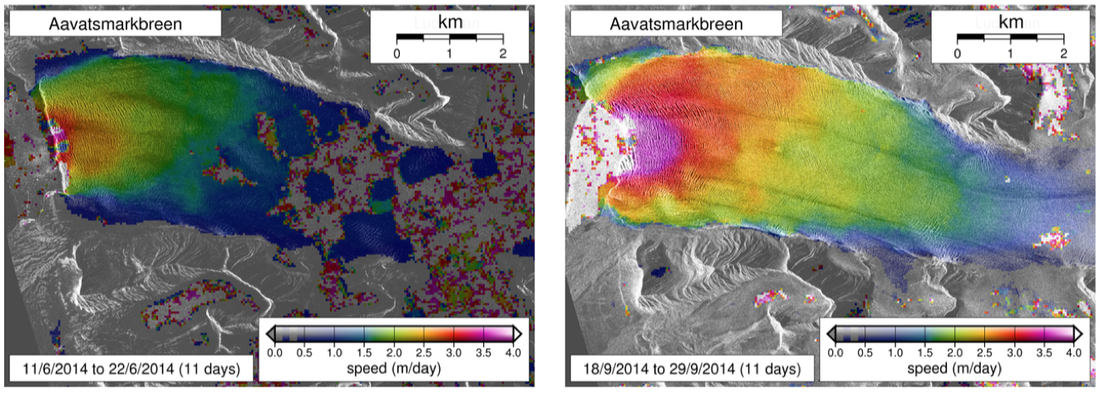
What Happens To A
Glacier When It Surges?
Rapid Speed Up
Terminus (the “end” of the glacier) can advance by kilometers
Satellite velocity maps of Aavatsmarkbreen, Svalbard, during a surge. A. Luckman. University of Swansea.
Notes:
Picture source - Doug Benn’s glaciology slides.

Slide 10
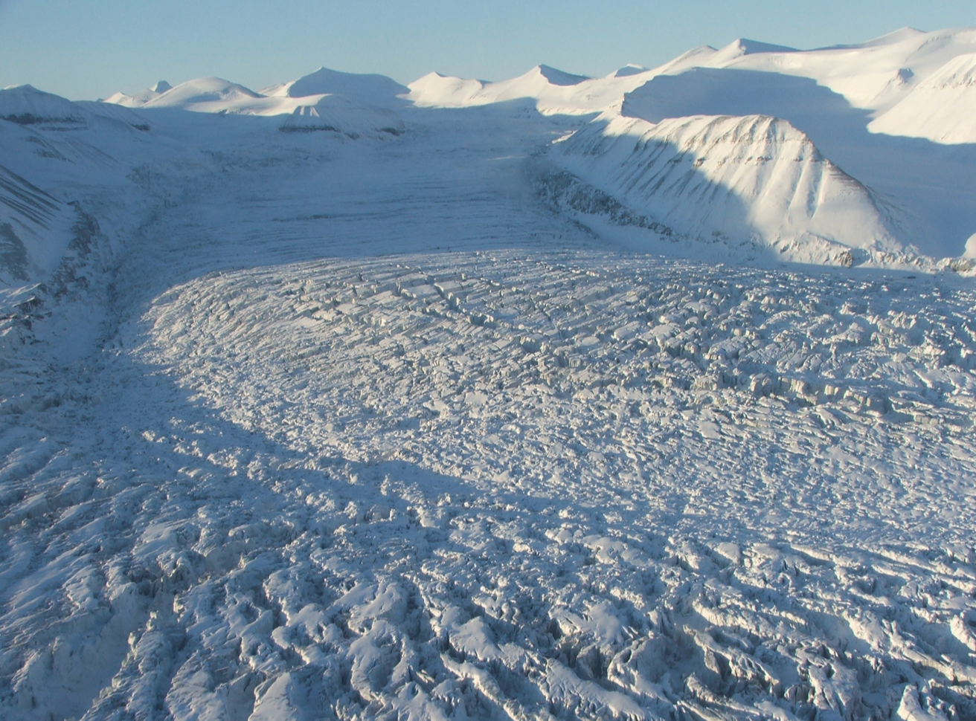
What Happens To A
Glacier When It Surges?
Accumulation Zone Thinning
Glacier drawdown during a surge. D. Benn, University of St Andrews.
Notes:
Ice is rapidly drawn down from the upper reservoir area to the ablation zone as the glacier speeds up. If downdraw is faster than accumulation, the accumulation zone thins.
Picture - Doug Benn’s lecture slides

Slide 11
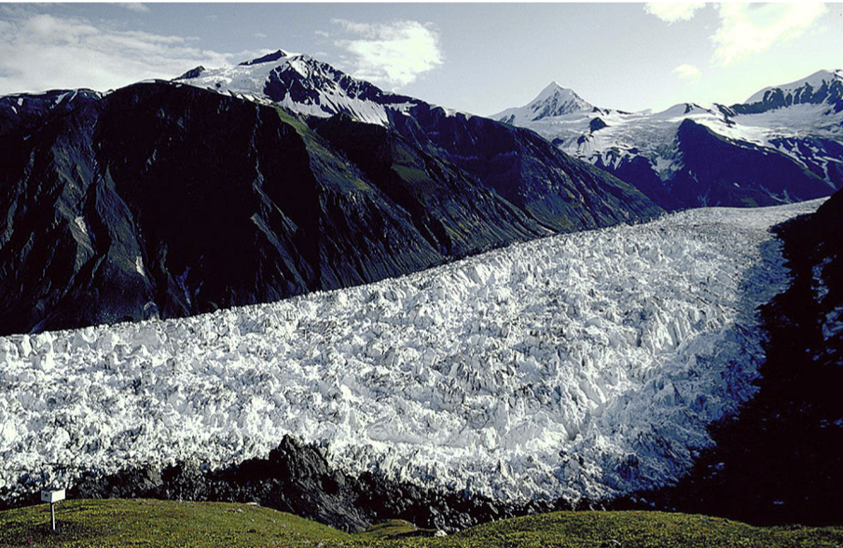
What Happens To A
Glacier When It Surges?
Crevassing
Crevassing on a Variegated glacier, Alaska. Swisseduc.ch
Notes:
The increased speed of the glacier pulls the surface apart and increases stresses, causing crevasses to be formed.
Crevasses allow more water to reach the bed by creating natural pathways for the water to flow. The water at the bed further increases the speed of the glacier due to increased sliding.
Image - https://www.swisseduc.ch/glaciers/glossary/surge-en.html

Slide 12
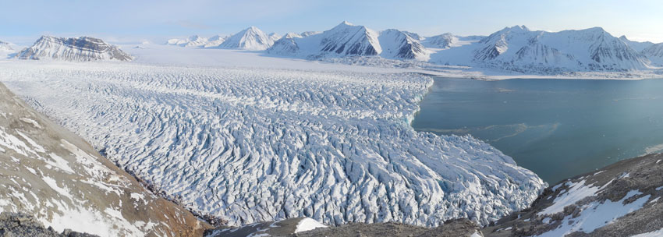
What Happens To A
Glacier When It Surges?
Eventual Melt and Thinning
Photo - unis.no
Notes:
After a glacier has stopped surging it will be thinner and longer than prior to the surge. More surface area is exposed to melting, so the glacier rapidly melts and retreats. If the glacier flows into water, increased calving occurs.
Photo - https://www.unis.no/ocean-temperatures-dictate-glacier-calving/dscn3292-dscn3297_nickhulton_850px/
Picture Source - Doug Benn’s glaciology slides

Slide 13
Why Do Surges Occur?
Build up of water at the bed decreasing friction and causing an increase in glacier speed
Increase in faster sliding and sediment deformation rate
Research is still underway to try and work out why some glaciers surge but others do not

Slide 14
True or False
All Glaciers Surge?
True or False

Slide 15
True or False
All Glaciers Surge?
True or False
False! Only ~1% of global glaciers are thought to surge.

Slide 16
True or False
A surging glacier can increase in speed to over ten times its normal rate.
True or False

Slide 17
True or False
A surging glacier can increase in speed to over ten times its normal rate.
True or False

Slide 18
True or False
When a glacier surges, the Accumulation Zone thickens and increases in size.
True or False

Slide 19
True or False
When a glacier surges, the Accumulation Zone thickens and increases in size.
True or False
False! When a glacier surges, ice from the Accumulation Zone travels rapidly into the Ablation Zone which leads to thinning!

