Slide 1
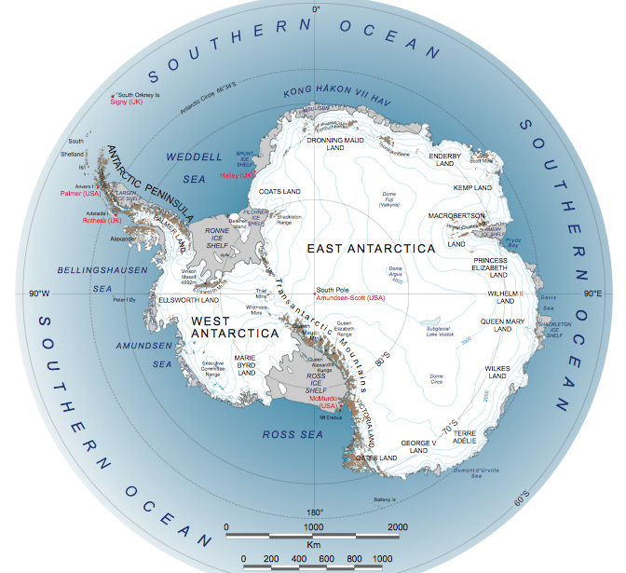
Glaciology
Marine Ice Sheet Instability
Notes:
Image source: https://www.businessinsider.com.au/nasa-west-antarctic-ice-sheet-results-2014-5

Slide 2
What is Marine Ice Sheet Instability?
To understand MISI, we must first define:
A ‘marine ice sheet’
A marine ice sheet is an ice sheet that sits on bedrock below sea level
E.g. the West Antarctic Ice Sheet
AND
A ‘grounding line’
A grounding line is the point where the grounded ice sheet transitions to a floating ice shelf
The position of this line influences the stability of a marine ice sheet

Slide 3
What is MISI?
The MISI hypothesis suggests that when a marine ice sheet is grounded on land that slopes downwards from the coast to the interior of the ice sheet, the grounding line is unstable
This configuration makes the ice sheet susceptible to rapid disintegration
Warming of the atmosphere and the ocean could cause increased melting and recession at the grounding line on a reverse slope

Slide 4
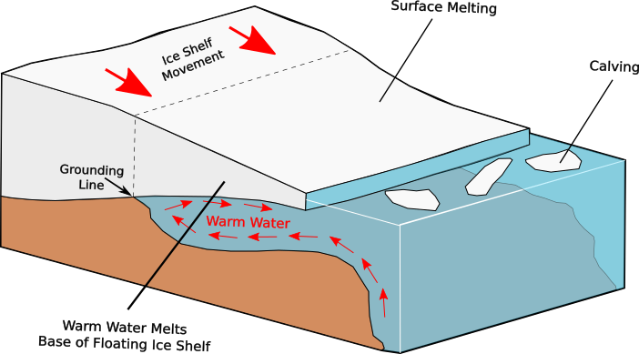
What is MISI?
Adapted by R.Jones from Hanna et al., 2013
Initial stable grounding line position with normal calving and surface melting.
Notes:
The figure displays an initially stable position with the grounding-line located on bedrock sill, sloping down towards the coast (Weertman, 1974).
Here, ice flux at the grounding-line equals total upstream accumulation.
If a perturbation, for example the incursion of circumpolar deep water (CDW) or changes in ice thickness (Benn and Evans, 2010) is applied at the grounding-line, basal melting will result.
The image shows CDW making contact with the ice sheet from below
As this CDW is relatively warm, heat is transferred to the bed of the glacier
This leads to basal melting at the grounding line
Subsequently, the ice-shelf thins and speeds up as a result of reduced buttressing effect
This paves the way for an increased ice flux through an increase in the breakaway of icebergs; a process called ‘calving’
This ultimately causes the grounding-line to retreat down the slope
Image source: Hanna, E., Navarro, F. J., Pattyn, F. Domingues, C. M., Fettweis, X., Ivins, E. R., Nicholls, R. J., Ritz, C., Smith, B., Tulaczyk, S., Whitehouse, P. L. and Zwally, H. J. 2013. Ice-Sheet mass balance and climate change. Nature.498, pp.51-57.

Slide 5
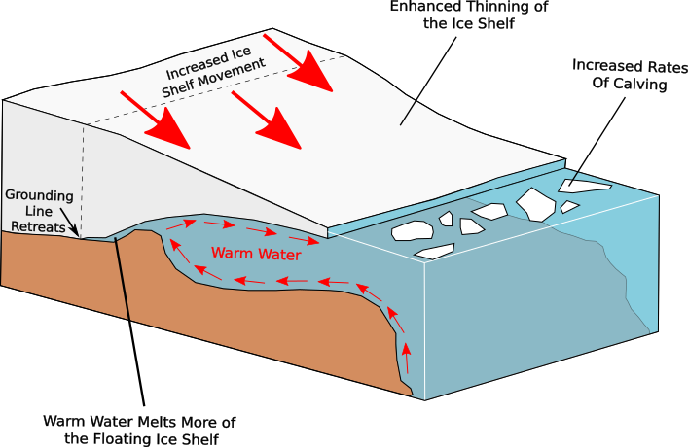
What is MISI?
Adapted by R.Jones from Hanna et al., 2013
b. Warm water causes a retreat of the grounding line. As the grounding line retreats inland down the slope, an unstable position is reached and the glacier undergoes increased thinning and calving.
Notes:
Now, the grounding-line is located on a retrograde slope – creating an unstable situation where the ice column at the grounding-line is thicker than before.
As thicker ice is associated with higher ice flux, the grounding line is forced to retreat further inland
Weertman (1974) demonstrated that ice flux at the grounding-line is dependent on the ice thickness there; thus, the thicker ice column leads to greater ice flux, outpacing upstream accumulation, forcing the grounding-line to retreat (ibid.).
Enhanced thinning and the associated increase of ice flux to the ocean will continue until a new stable position is reached
Image source: Hanna, E., Navarro, F. J., Pattyn, F. Domingues, C. M., Fettweis, X., Ivins, E. R., Nicholls, R. J., Ritz, C., Smith, B., Tulaczyk, S., Whitehouse, P. L. and Zwally, H. J. 2013. Ice-Sheet mass balance and climate change. Nature.498, pp.51-57.

Slide 6
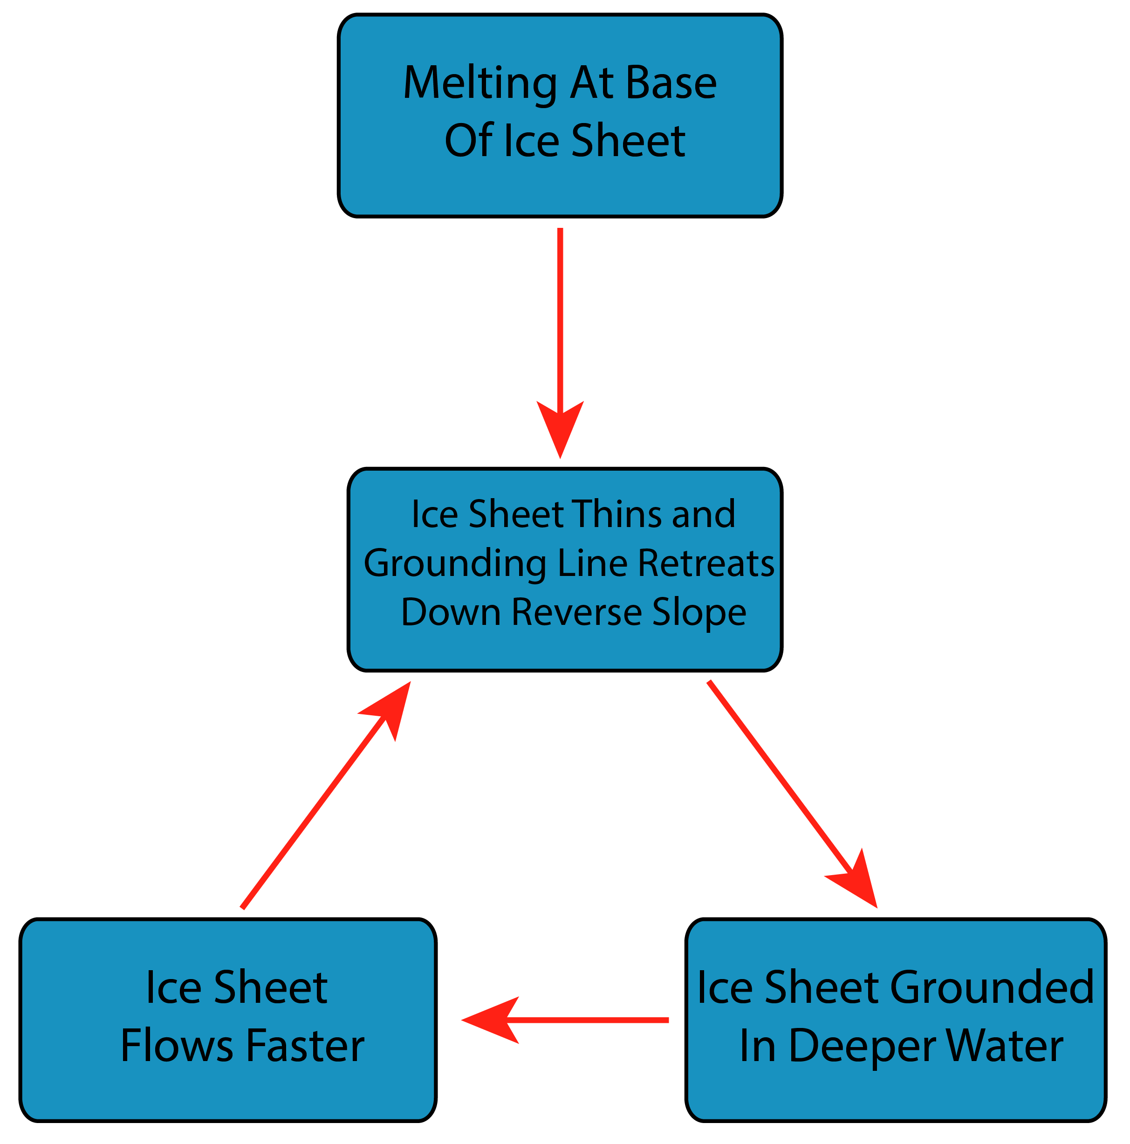
MISI as a Positive Feedback Loop
R.Jones, GeoBus, University of St Andrews
Notes:
This initiates a positive feedback system where grounding line retreat only stops when a new stable position is reached
E.g. a bedrock high or a pinning point where ice flux at the grounding line and upstream accumulation match again

Slide 7
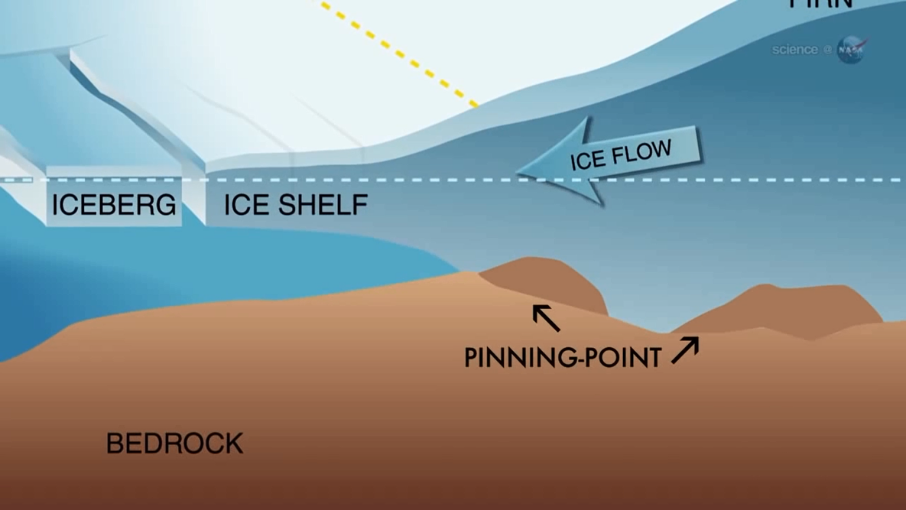
What is MISI?
Image illustrating a pinning point, from the arctic sea ice forum
Notes:
This new stable position could a bedrock high or a pinning point, for example, where ice flux at the grounding line and upstream accumulation match again
Image source: https://forum.arctic-sea-ice.net/index.php?topic=874.100

Slide 8
Why does it matter?
MISI is a major concern amongst scientists today
Historically, the Antarctic Ice Sheet (AIS) was deemed stable, with a positive mass balance and an entirely cold interior and slow rates of flow
However, recent work on MISI and improvements in mass balance estimates reveal that the AIS is not stable at all

Slide 9
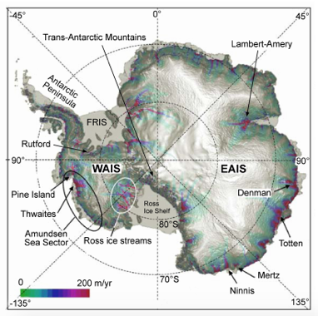
Why does it matter?
The AIS is divided into the East (EAIS) and West Antarctic Ice Sheet (WAIS) by the Transantarctic Mountains
Relief map of the AIS highlighting the larger EAIS and the smaller WAIS. These two sections are divided by the Transantarctic Mountains (Bamber and Aspinal, 2013: 424)

Slide 10
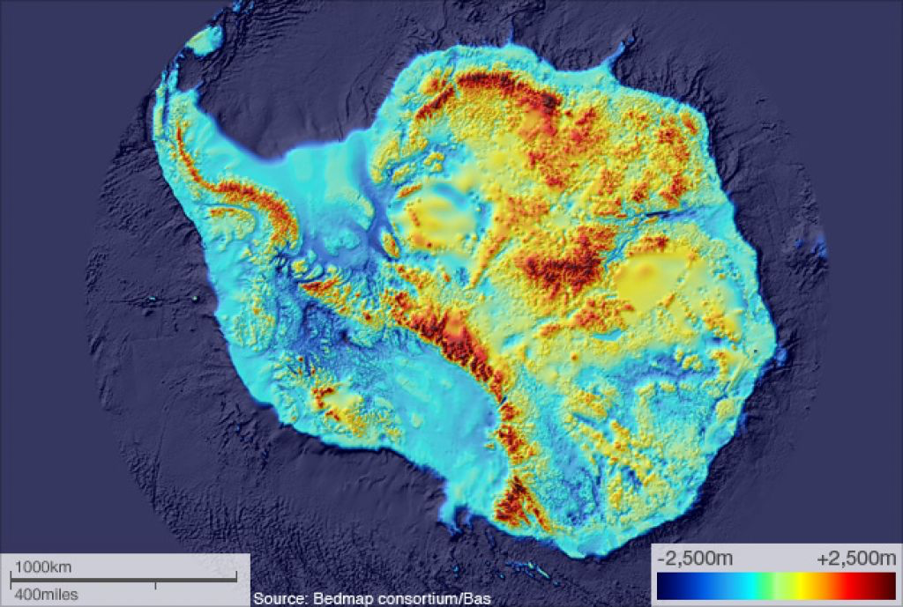
Why does it matter?
The EAIS rests mainly on land, so it is more stable
BUT, the WAIS is thought to be unstable as it rests on beds below sea level with retrograde slopes
Land cover of the Antarctic Ice Sheet, showing upland areas in red and lowland in blue. The West Antarctic Ice Sheet is seen to be a deep hollow, meaning it is unstable.
antarctica.gov.au
Notes:
Source: http://www.antarctica.gov.au/science/cool-science/2011/bedrock-map-reveals-ice-free-antarctica

Slide 11
Why does it matter?
The bed of the WAIS gets deeper further inland, creating a vulnerable situation
This instability is occurring at Thwaites glacier, generating concerns regarding sea level rise
Limited SLR potential from Thwaites (<1m)
BUT, is generating concern given that Thwaites is deemed the ‘plug’ of the WAIS and thus the AIS (total of ~57m SLR potential)
Notes:
The AIS has a sea level equivalent of ~57m; the WAIS contains ~14% of this, generating concerns for future sea level rise

Slide 12
True or False
The position of a grounding line plays a key role in determining the stability of an ice sheet.
True or False

Slide 13
True or False
The position of a grounding line plays a key role in determining the stability of an ice sheet.
True or False

Slide 14
True or False
The Marine Ice Sheet Instability hypothesis suggests that when a marine ice sheet is grounded on land that slopes downwards from the interior of the ice sheet to the coast, the grounding line is unstable.
True or False

Slide 15
True or False
The Marine Ice Sheet Instability hypothesis suggests that when a marine ice sheet is grounded on land that slopes downwards from the interior of the ice sheet to the coast, the grounding line is unstable.
True or False
False! It is when the marine ice sheet is grounded on land that slopes downwards from the coast to the interior of the ice sheet that the grounding line is unstable.

Slide 16
True or False
Scientists are concerned that Marine Ice Sheet Instability may occur at the East Antarctic Ice Sheet.
True or False

Slide 17
True or False
Scientists are concerned that Marine Ice Sheet Instability may occur at the East Antarctic Ice Sheet.
True or False
False! It is the West Antarctic Ice Sheet that scientists are concerned about.

Slide 18
True or False
Marine Ice Sheet Instability at the West Antarctic Ice Sheet has the potential to significantly raise global sea level.
True or False

Slide 19
True or False
Marine Ice Sheet Instability at the West Antarctic Ice Sheet has the potential to significantly raise global sea level.
True or False

